Slide 1
Configuration Steering Board
[Program Title]
Template to be used as a guide
Briefing should focus on requirements changes but additional programmatic information may be added where board member input on decisions are required or when it adds value for the SAE
Notes pages contain additional explanation/guidance
Rank, Name
Office Symbol
Date of Briefing
Version #

Slide 2
Why We Are Here Today
Information to include:
  Requirement changes that affect cost / schedule
  Recommendations on requirement changes to improve cost / schedule

Slide 3
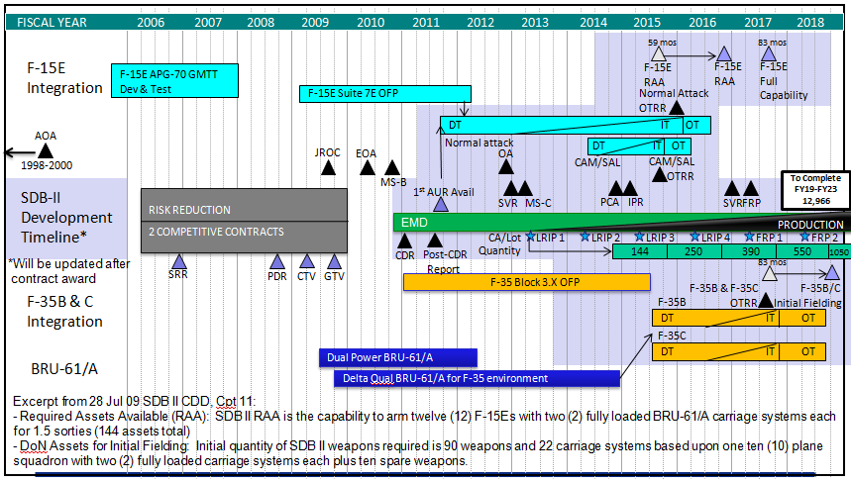
Program Description/Overview
Description
Schedule
  250-lb Class, Precision Guided, Air-to-Ground Munition
  Kill Mobile and Fixed Targets Through Weather from Standoff
  Uses Tri-Mode Seeker & Dual-Band Data Link (Link 16 + UHF)
  Services: USAF, DoN
  Threshold Platforms: AF--F-15E; USMC--F-35B; USN--F-35C
  IMD sensitive (for clarification see notes)
  ACAT Level: ID
  MDA: USD (AT&L)
  PEO:
  PM:
EXAMPLE
Approved Funding
Acquisition Strategy
  Evolutionary Acquisition
  Competitive Risk Reduction / Source Selection
    Prime: Company A
    Major Sub: Company B
  EMD-Fixed-Price Incentive Firm Target (FPI(F))
  Production
      Lots 1-3 -- FPI(F)
      Lots 4-5 – Fixed-Price NTE w/ Economic Price Adjust
  Phase Verification:
      Phase I—description
      Phase II—description
      Phase III—description
3

Slide 4
Potential New Requirements; New and Evolving Threat Analysis
New / Evolved Threat | Requirements Challenge | Mitigation
New adversary capability X | Requirement C may not be sufficient for future missions | Engage AFROC process; New capability will start new ACAT enhancement program if >$100M
New adversary capability Y | Intel Mission Data Requirements will not account for new threat | Work with AF/A2 to ensure all IMD req’ts can be met within existing budget
New adversary capability Z | Connectivity with program A will create a Cyber Vulnerability | Remove requirement to connect to program A

Slide 5
Requirements Changes (+/-) since last CSB
New / Refined Requirement | Threshold / Objective | Rationale for New Requirement | Current Est. | Cost / Schedule / Affordability Impact | Approved / Authority
Weight | 7500 lbs / 6600 lbs | AMC/A3/5 identified new weight requirement updated to allow transport in … | 7650 lbs | $$ Increase: AMC providing funding No Schedule impact | PENDING / CSB
Resolution | 7 cm / 5 cm | New threat identified by xxxx and being worked through AFROC that … | 6.8 cm | Threat to MS-C Schedule – need requirement finalized by XXX to maintain schedule | PENDING / CSB
Example 3 | 4.0 | Reallocation | 4.0 | N/A | YES / CCB 15JAN14
Purpose of this slide is to identify requirements changes that will impact cost and schedule even if they don’t change KPPs or KSAs. Also, purpose is to address proposed updates or refinements to requirements identified by the User or other organizations.

Slide 6
Configuration Update
Not Required for Pre-MS B programs.
Previous 12 Months
ECP | Performance Impact | Schedule Impact | Cost / Affordability Impact | Interfaces Affected | Approved / Authority
Disconnected Waypoints | Incorporates more operationally relevant method of handling non-sequenced points during route planning | None. Change incorporated in subsequent, planned release | $200M Total across FYDP | User Interface only | PENDING / CSB
Mission Data Load Handler | Allows for proper handling of mission data loads for multiple aircraft OFPs from single workstation | None. Change incorporated in subsequent, planned release | $569K – all FY08 funds | User Interface only | APPROVED / CCB
Identify all ECPs affecting form, fit, or function from past 12 months and all anticipated during the next 12 months.
Next 12 Months
ECP | Performance Impact | Schedule Impact | Cost / Affordability Impact | Interfaces Affected | Approved / Authority
None | N/A | N/A | N/A | N/A | N/A

Slide 7
Potential De-scoping Options
Option | User Capability Assessment and Perf Impact | Impact to remaining program | Investment to date | Savings
Defer Mode S | Low-to-med impact in FY08-13 timeframe: Risks denial to European airspace | No impact | $12M spent of an estimated $36M effort | $24M Total: $3M FY08 $8M FY09 $10M FY10 $3M FY11
Reduce sensor resolutions by 50% | Med impact in FY10-11 and High impact in FY12-21: Inability to … | Changes critical path to xxxx; reduces schedule risk by four months | $3M spent in risk reduction; total effort estimated at $87M | $84M Total: $2M FY08 $7M FY09 $15M FY10 $23M FY11 $28M FY12 $9M FY13
Etc.
 | * What would program descope to address a FUNDING CUT
Include bumper sticker on slide stating whether the de-scoping options are recommended or not.
In consultation with the MAJCOM, provide three or four achievable requirements de-scoping options based on User inputs. For each of these options, capture impacts to program’s ability to execute and overall savings to PEO and/or Air Force TOA.

Slide 8
Recommendations
Recommend way ahead for SAE
Discuss requirement issues. Examples might be:
  Request to reduce Requirements for Cost
  Request to reduce Requirements for Schedule
  Technical transition issues to meet requirement affecting cost and schedule
  New unfunded requirements/refinements
Be clear about what help you request and from whom

Slide 9
Other Slides as Appropriate

Slide 10
Identify How New / Reduced Requirements Affect Schedule
FY01 FY02 FY03 FY04 FY05 FY06 FY07 FY08 FY09 FY10 FY11 FY12 FY13
MDD
IOC
FDDR
Milestones
MAIS List
AFRB
FOC
RIT
ICD
Requirements Review/Management Board
Requirements
Annual
X-Plan
Design & Integration
System/Architecture Studies
Highlight critical path
Acquisition
Test & Evaluation
OUE
OT&E
Procurement
Operations & Support
  Strategic & focused on Milestones and critical events between Milestones; must communicate schedule changes
10

Slide 11
Spruill Chart

Slide 12
Identify How Requirements Changes Affect Affordability
 | Affordability Cap (BY13$B) | Current Estimate (BY13$B)
APUC | 2.0 | 1.9
O&S* | 10.0 | 9.0
*Indicate whether O&S is for entire weapon system or the ACAT I program in question
Affordability Challenge | Mitigation
Requirement A is more difficult, more costly to achieve than expected at APB | Reduce threshold to X -- maintain current affordability cap
User-Requested addition of Requirement B | Increase affordability cap -- critical capability adds distinct value, more expensive to wait for future increment
12

