Slide 1
Defense Acquisition Executive Summary (DAES) Overview
SAF/AQXE
27 Oct 2020
1

Slide 2
Topics
Overview
DAES Policy Guidance
Who reports
Unit Cost Report
When do programs report
DAES Group Schedule
OSD Watch List
SAF/AQX Review

Slide 3
Overview
DAES Overview
  Quarterly process for OSD to review MDAP, MAIS, and special interest programs
  DAES information is designed to provide early-warning reporting to the USD(A&S)
  DAES assessments serve two purposes:
    Provide awareness of program execution status
    Enable identification of emerging execution issues that warrant the attention of senior leadership
DAES is a 2-month process includes:
  Month 1: PM reporting
  Month 2: OSD assessment
PEOS | PEOs submit DAES reports and risk/reliability growth curve (RGC) slides for their programs in Group A, B, or C (one group each month) to SAF/AQXE one week prior to the end of the month
SAF/AQXE | SAF/AQXE reviews documents, conducts quality check, interfaces with OSD and submits to OUSD(A&S)/ARA the last day of the month.
OUSD Staff | OSD is the recipient/customer of DAES reports. OUSD Staff reviews the reports and assesses each DAES program in 11 categories: Cost, Schedule, Performance, Funding, Test and Evaluation, Sustainment, Management, Contract Performance, Interoperability/Information Security, Production, and International Program Aspects. Programs are rated Green, Yellow, or Red (“Stoplight” ratings)

Slide 4
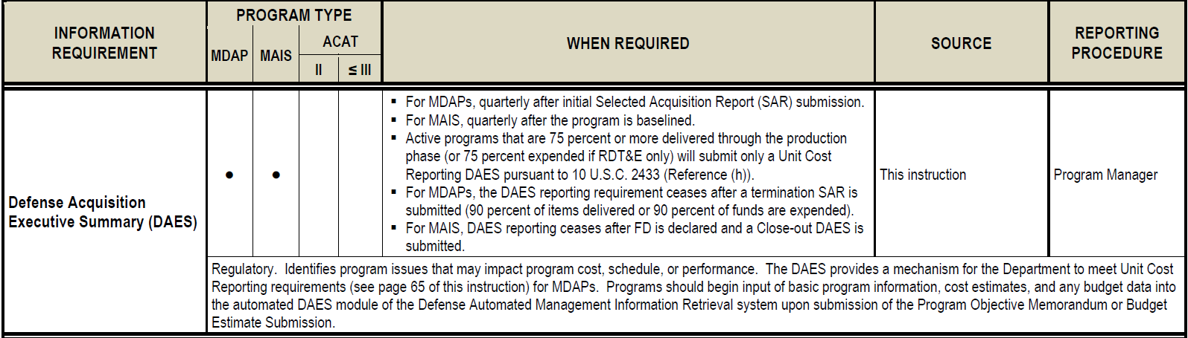
DAES Policy
Regulatory Requirement, DoDI 5000.02
DoDI 5000.02, Table 5 “Recurring Program Reports”

Slide 5
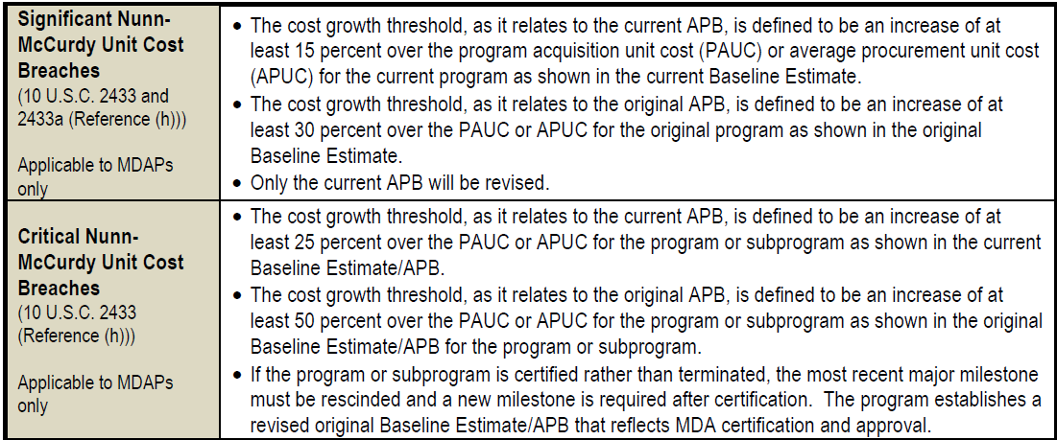
DAES Policy
Statutory Requirement, 10 U.S.C. 2433
DoDI 5000.02, Table 4 “Statutory Program Breach and Change Definitions”
DoDI 5000.02, Table 5 “Recurring Program Reports”

Slide 6
Who Reports?
All programs on OSD oversight list (ABC List) must report quarterly
  Frequency
    Quarterly for all MDAP and MAIS programs
  Initial DAES
    MDAP begin after the program submits an initial or quarterly SAR
    MAIS begin after the program is baselined
  Final DAES
    Executive Summary must state “This is the final DAES.”
    MDAP stop DAES reporting due to any of the following factors:
      Final SAR submitted
      90% delivered
      90% funds expended
      Middle-Tier Acquisition approval
      Program termination
    MAIS stop DAES reporting due to any of the following factors:
      Reaching Full Deployment
      Program termination

Slide 7
Unit Cost Report-Only Reports
Unit Cost Report (UCR) Only Report
  UCR-only report must be noted in OSD Oversight List
  UCR-only report granted due to any of the following factors:
    75% or more delivered
    75% or more expended
  UCR-only reports include the following sections under "Manage Report Sections" are submitted:
    Executive Summary
    Schedule
    Performance
    Cost and Funding
    Unit Cost
    Contracts
    Deliveries/Expenditures

Slide 8
When do Programs Report?
Programs provide a DAES report quarterly
OSD has bucketed the MDAPs and MAIS programs into three groups: A, B, and C
  Each month, one group submits a DAES report and another group has its DAES reports assessed by OSD and posts the Program Assessment and Recommendation report in AIR
  Example:
    In March, Group C programs submit DAES reports, OSD assesses Group B DAES reports, and OSD posts the Program Assessment and Recommendation report in AIR.
    In April, Group A programs report, Group C program reports are assessed, and OSD posts the Program Assessment and Recommendation report in AIR.

Slide 9
DAES Group Schedule
As of 01 Oct 19
Month | PM Report | OSD Assess
Jan | A | C
Feb | B | A
Mar | C | B
Apr | A | C
May | B | A
Jun | C | B
Jul | A | C
Aug | B | A
Sep | C | B
Oct | A | C
Nov | B | A
Dec | C | B
Group A | Group B | Group C
APT | AMRAAM | AWACS Blk 40/45
*C-130J | B-2 DMS-M | B-61 Mod 12 LEP TKA
HC/MC-130 Recap | DCAPES Inc 2B | HH-60 W: CRH
KC-46A | EPS | F-22 Inc 3.2B Mod
MQ-9 Reaper | F-15 EPAWSS | GPS III
SBIRS High: Block Buy 5-6 | FAB-T CPT | GPS IIIF
WSF | JASSM: ER | ICBM Fuze Mod
MH-139A: UH-1N Replacement | NSSL | MGUE Inc 1
 | SDB II | OCX
 | VC-25B | F-35 (Reporting provided through Navy)
 | WGS
* = 75% Delivered (UCR)

Slide 10
OSD Watch List
Overview
  OSD cancelled their quarterly DAES Meetings with the DAE
  OSD Acquisition Analytics and Policy Prioritized Watch List is the replacement for these meetings and warns the DAE of potential breaches instead of just reporting the breach after it occurs
  Reports focus on select programs from the previous DAES and are located in AIR
  Programs should review list and let us know if you have any comments that need to be relayed to OSD
  Watch list is sent to the SAE
Watch List consists of the following sections:
  BLUF
  Updated Issues From Previous Reporting
  Consequences

Slide 11
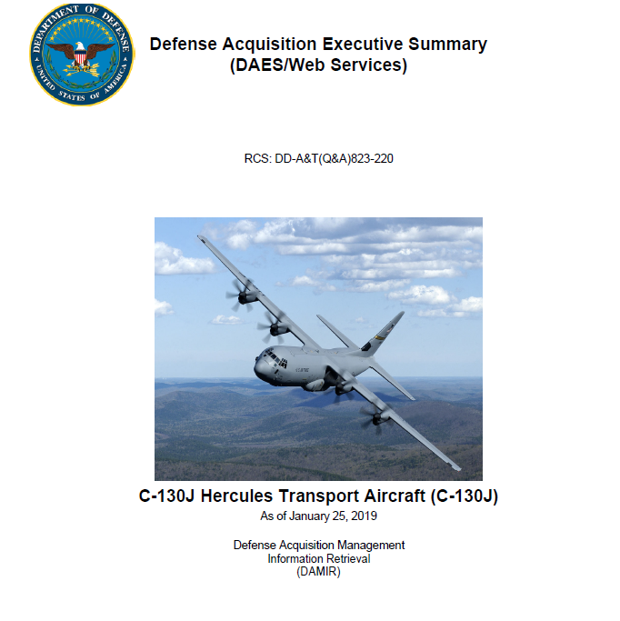
SAF/AQ
DAES Report Overview
DAES Report Section
SAF/AQX Strategic Messaging
Executive Summary Review
Skim for breach discussions or if first line states “This is the final DAES” – inform DAES POC if report has breach or is final report
OSD Coordination
Program DAES group assignments
DAES final submission notification
  MDAP 90% fund expended
  MDAP 90% delivered
  Middle-Tier Acquisition approval
  Final SAR submission
MAIS full deployment
DAES UCR-only List
OSD DAES Watch List
SECAF Acquisition Day
Acquisition program metrics
Program execution analysis
Acquisition Breaches
Cost growth compared to APB (orig & current)
Schedule growth compared to orig. APB
Program Strategic Messaging
Congressional Inquiries
Government Accountability Office Inquiries
National Defense Strategy Monthly Briefing
Selective Acquisition Report
Monthly Activity Report
SAF/AQ Principals Monthly Brain Book
Identification of possible USAF trending issues
Capability Directorate Talking Papers
MDAP Percent Expended
Check “Deliveries and Expenditures” data section
Assess if the current report is the first submission that reports over 75% or over 90% expended or delivered
75% drives UCR only report
90% drives final report and possible removal from MDAP list
Current Estimate Delta Explnation
Check “Unit Cost” data section
Compare unit cost current estimate with the previous DAES report
Check “Cost and Funding” data section -- confirm program provided an explanation to explain variation in their current estimate
APB Threshold Review
Check “APB Breaches” data section
Assess if any breaches are flagged (system will automatically flag a breach, if applicable)
If breach appears, click on the applicable data section to gather additional information on cause of breach
Program Assessment
Review program manager’s assessment
Consider PM’s inputs and impact to program strategic messaging
DAES Report Assessments Inform SAF/AQ Strategic Messaging

Slide 12
Re-Purposed DMAG DAES fields
Beginning with the October 2020 DAES Submission, the following DAMIR DAES Fields are no longer used in support of the Quarterly DAES submissions, to make room for DMAG data:
  Mission & Description –> Executive Summary
  General Contract Notes –> Prime and Subcontractor
  General Memo (Contract Budget) –> Get to Green
  RDT&E Memo (Contract Budget) –> Goals/Future Contracts/Incentives
  Nuclear Cost –> Risks & Issues, Mitigations
  Schedule Acronym & Abbreviation Table –> non-APB milestones
  PM Assessments: Cost, Schedule, Performance, and Funding -> Ratings
Notes:
Repurpose is occurring because of DMAG
Deputy’s Management Action Groups (DMAG) primary mission is to advise the Deputy SecDef in a collaborative environment and to ensure that the DMAG execution aligns with the SECDEF’s priorities as well as the planning and programming schedule.
You are not responsible for DMAG Submissions. The PEMs are and will have edit access to your reports.
I may not know the answer to all your questions but will get back with you. Please bare with me.
Programs affected: B-2 DMS-M
AWACS
EPAWSS
FAB-T
ICBM Fuze
KC-46A
MGUE Inc 1
NSSL
SBIRS
SDB II
OPIR

Slide 13
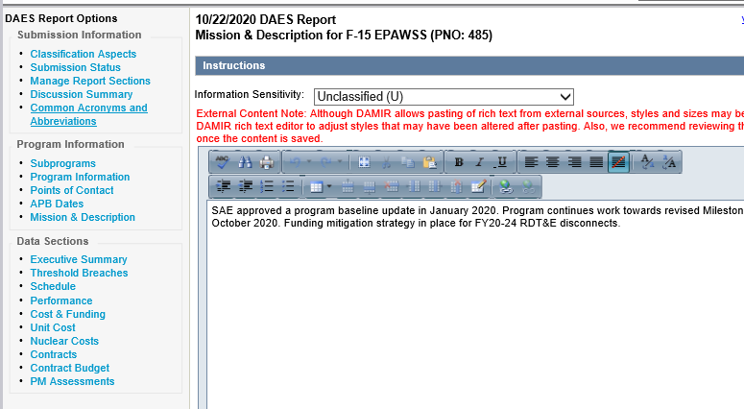
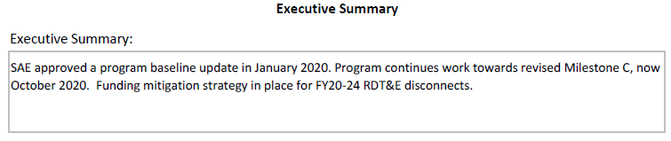
Executive Summary
DMAG Executive Summaries will be captured in the Mission & Description section of DAES
PDF
DAES
EXAMPLE
Highlight changes from last month’s information with an asterisk (*) before AND after the changed information
EXAMPLE

Slide 14
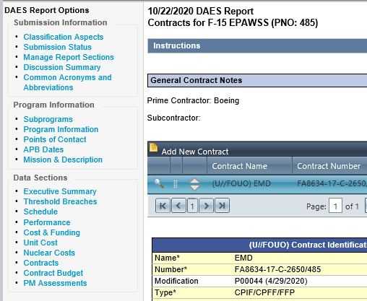

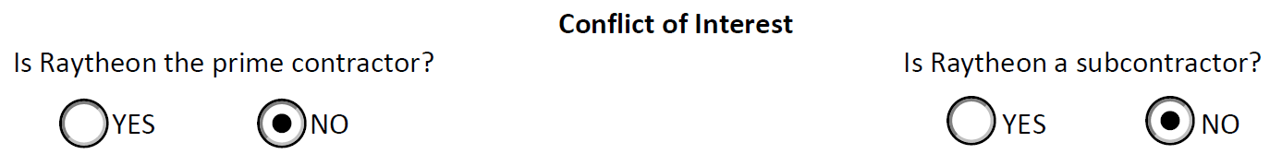
Prime and Subcontractor
Prime Contractor and Subcontractor fields are captured in the General Contract Notes section of DAES. Only list a Subcontractor if it is Raytheon.
PDF
DAES
EXAMPLE
EXAMPLE

Slide 15
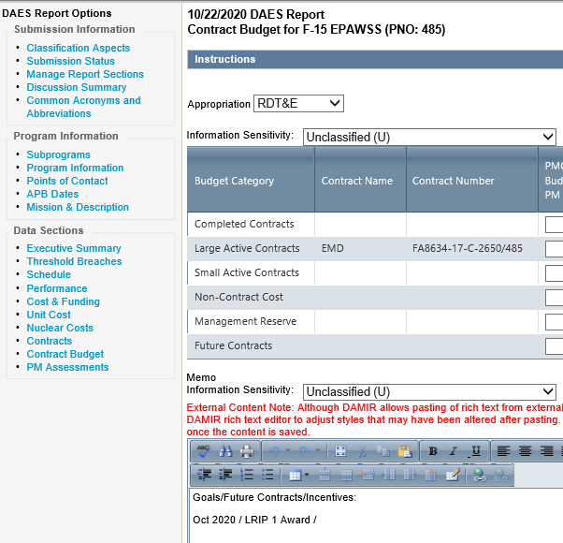
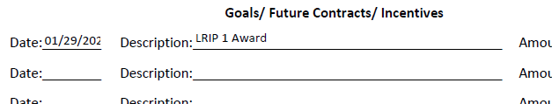
Goals/Future Contracts/Incentives
Goals/Future Contracts/Incentives are captured in the RDT&E Memo Notes of the Contract Budget section in DAES
PDF
DAES
EXAMPLE
Use this format:
Nov 2020\ Description of the future contract\ 83.7
Highlight changes from last month’s information with an asterisk (*) before AND after the changed information
EXAMPLE

Slide 16
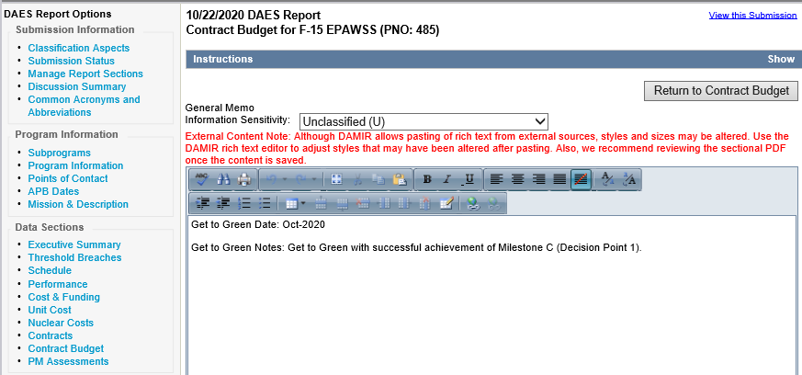
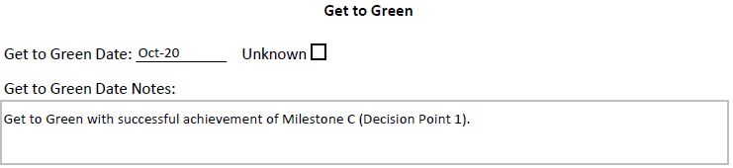
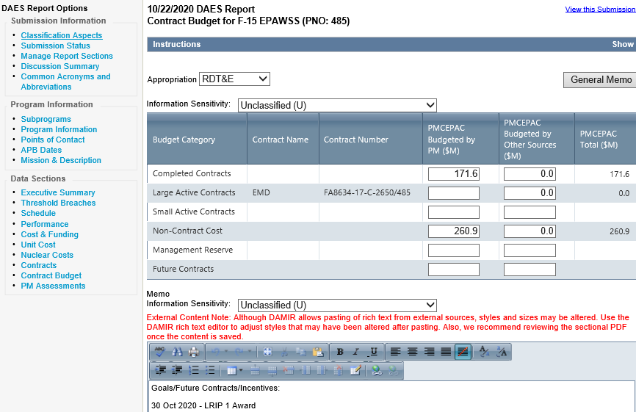
Get to Green
Get to Green is captured in the General Memo of the Contract Budget section in DAES
DAES
PDF
EXAMPLE
Highlight changes to get to green notes with an asterisk (*) before AND after the changed information. Changes to the get to green date itself do not need to be surrounded by (*s).
EXAMPLE

Slide 17
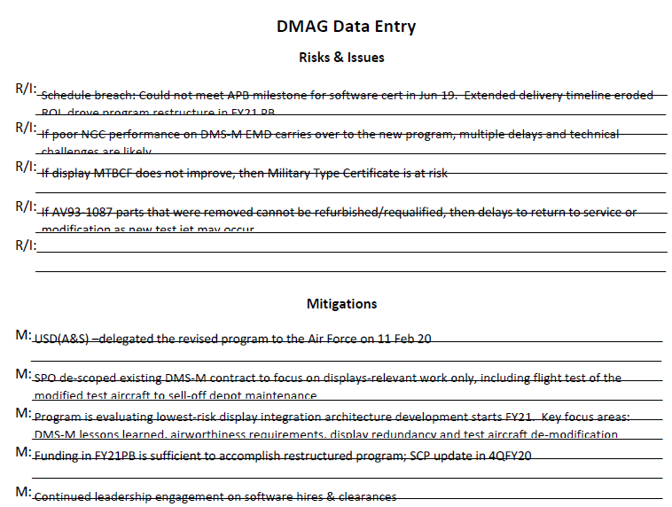
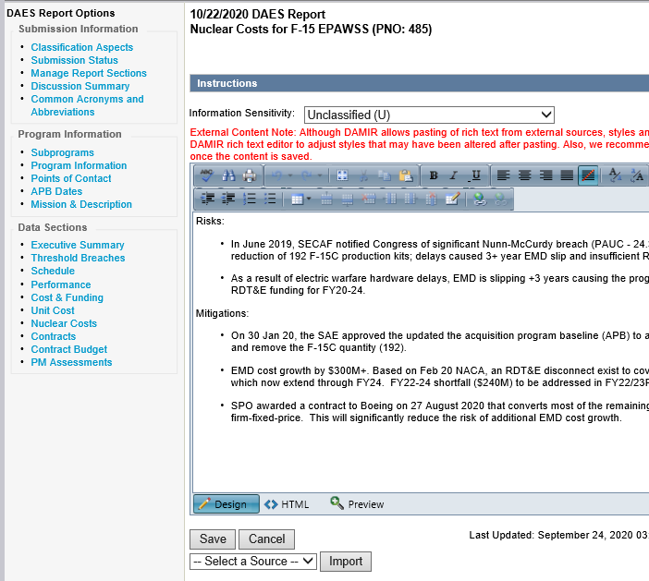
Risks & Issues, Mitigations
Risks & Issues and Mitigations are captured in the Nuclear Cost section of DAES
PDF
DAES
EXAMPLE
Highlight changes from last month’s information with an asterisk (*) before AND after the changed information
EXAMPLE

Slide 18
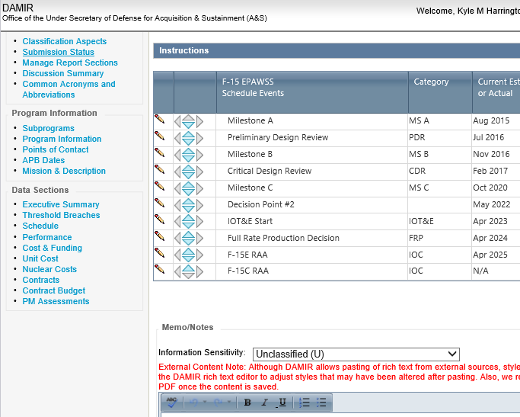

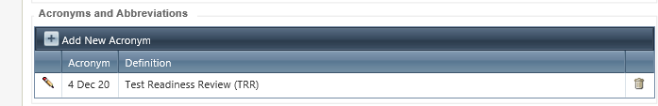
Non-APB Milestones
Program Milestones (non-APB) are captured in the Acronyms and Abbreviations table within the Schedule section in DAES
PDF
DAES
4 Dec 20
Test Readiness Review (TRR)
EXAMPLE
Highlight changes from last month’s description with an asterisk (*) before AND after the changed information. Changes in milestone dates do not need to be marked, only changes in the description.
EXAMPLE

Slide 19
Ratings
Cost/Schedule/Performance/Risk
PM Assessments: Cost, Schedule, Performance, and Funding – Do not use Cost, Schedule, Performance, and Funding assessment indicators and summary statements for the DAES Quarterly submission. Instead, use the Management indicator as a summary for all categories. Choose a single rating for the Management indicator that reflects the lowest rating (Red is the lowest rating) of the five assessment categories. Include the rating and explanations for Program Cost, Program Schedule, System Performance, Funding, and Management in the Management indicator. *NOTE: The Funding Section will now be used for Risk Assessment Rating. This section will be renamed in the near future to assist with confusion.
OSD assessing organizations will continue to provide their assessments against the PM Cost, Schedule, Performance, and Funding, as you provide it in the Management indicator. They will include those assessments in the fields now marked DMAG – Cost (formerly Program Cost), DMAG – Schedule (formerly Program Schedule), DMAG – Performance (formerly Program Performance), and DMAG – Risks/Other (formerly Program Funding).
Notes:
*NOTE: The Funding Section will now be used for Risk Assessment Rating. This section will be renamed in the near future to assist with confusion.

Slide 20
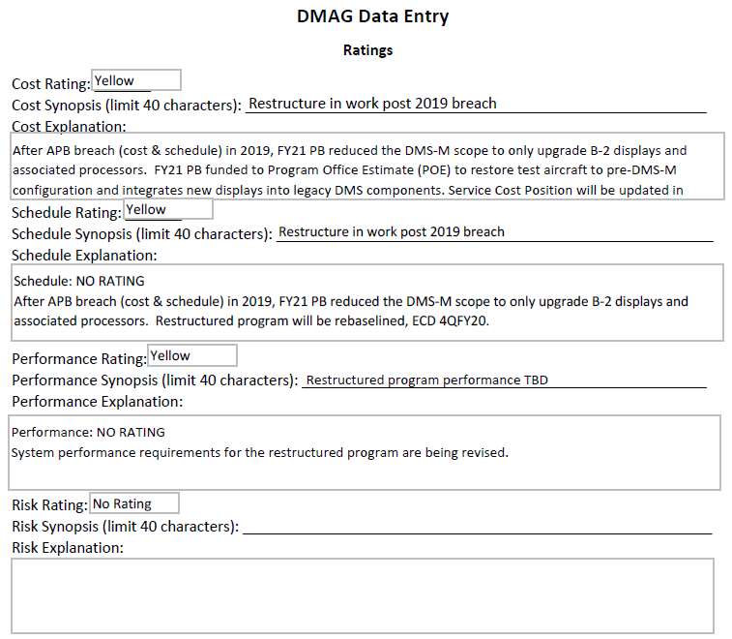
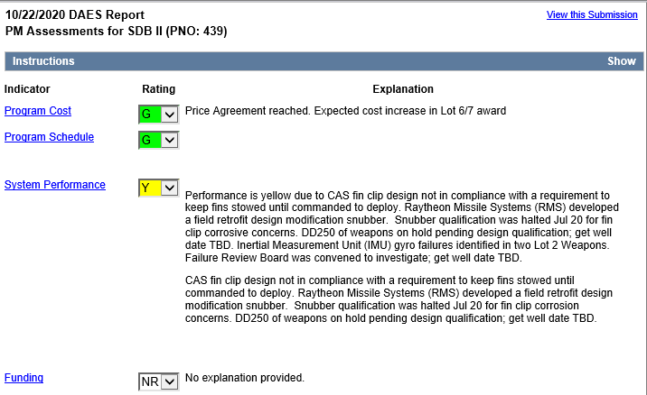
Ratings
Cost/Schedule/Performance/Risk
PDF
DAES
EXAMPLE
EXAMPLE
Field name to be changed to “Risk” in Nov 2020
Highlight changes from last month’s information with an asterisk (*) before AND after the changed information

Slide 21
Selected Acquisition Reports (SARs)
SAF/AQXE
27 Oct 2020

Slide 22
Topics
Overview
SAR Submission Sequence
Major Requirements of SAR Packages

Slide 23
What is a SAR?
PEM Orientation and Flowchart
Selected Acquisition Reports (SAR): Provides status of a program
  A standard, comprehensive summary reporting of schedule, performance, and cost information on MDAPs within the DoD and delivered to Congress
Req Docs
PEM Process
REVIEW Process
Info Types
PROGRAM
BASELINE
(APB & SAR)
MISSION
DESCRIPTION
SAR Sections
(as applicable)
PEO
Executive Summary
Program Background Info
Mission and Description
References
Track to Budget
Schedule
Performance
Cost and Funding
Unit Cost Information
Cost Variance
Threshold Breaches
Contract Info
Deliveries and Expenditures
Operational &Support Costs
Enhanced SAR
MILESTONE
SCHEDULE
COMPTROLLER
INDICES
COMPONENT
ACQUISITION
EXECUTIVE
*SecAF &
CSAF
Certification
Memo
PRESIDENT’S
BUDGET
PERFORMANCE
DEFENSE
ACQUISITION
EXECUTIVE
COST
CONTRACTS
CONTRACT
INFORMATION
CONGRESS
OTHER
DOCUMENTS
* New SAR Certification requirement
Notes:
The areas circled in blue are areas the PEMs should be focused on reviewing for accuracy.

Slide 24
SAR Submission Sequence
Initial SAR reporting begins with the Program Initiation decision
  For most MDAP programs this will be Milestone B
  Program must have an MDA-approved APB
  A SAR submission is expected in the same fiscal year as the Milestone B decision
After the Initial SAR Submission all MDAPS must report the Annual December SAR
Quarterly SAR
  Initial SAR/Final SAR (90% Delivered/90% Expended; No longer meets MDAP $ threshold)
  Schedule breach of 6 months or more
  Nunn-McCurdy
Notes:
WSF
KC-46A
MGUE Inc 1
RDTE: $480M (FY14 Constant)
Procurement: $2.79 B (FY14 Constant)

Slide 25
Major Requirements of SAR Packages
Annual SARs due to Congress 30 days after the President’s Budget
Quarterly SARs are due to Congress 45 days after end of fiscal year quarter (March, June, September)
  SAR Submission
    SAR
    Enhanced SAR – all programs
    Classified SAR, if applicable
  SecAF/CSAF Certification IAW FY17NDAA/10USC Section 2430 - requirements are stable and funding is adequate to meet cost, schedule, and performance
    PEO certification recommendation
    One-page Executive Summary
    SAR Executive Summary section
  SAR-like Reports for MTA programs (Rapid Prototyping and Rapid Fielding)

Slide 26
QUESTIONS?

