Slide 1

This template is for guidance only
and is not mandatory.
Examples are for illustrative purposed only
Rank, Name
Office Symbol
Date of Briefing
Updated April 2018
See footnotes on each page for additional guidance

Slide 2
MDD Overview
BLUF – purpose of meeting (requested decision)
Requirements
Development Planning
AoA Study Guidance & Plans
Funding & Staffing for Materiel Solutions Analysis Phase
Affordability Constraints
Acquisition Recommendations
Requested Decision
Notes:
While it is not mandatory, nor possible, in one hour to address all the subjects, it is prudent to be prepared to brief or address all topics. The current AQ likes to focus on discussion of issues versus just briefing charts.

Slide 3
BLUF
Meet the requirements of an MDD
  Establish ACAT level
  Establish lead service/organization
  Establish acquisition life cycle entry point
Decision(s) sought
  Proceed with OSD engagements to prepare for MDD
  Approve entry into requested phase
Major issues (if any)
Notes:
Tailor for appropriate level SAF/AQ, OSD
The first part of the briefing it would be appropriate for the sponsor to brief.
Purpose of Meeting
Decision(s) Requested
Major Issues (if any)

Slide 4
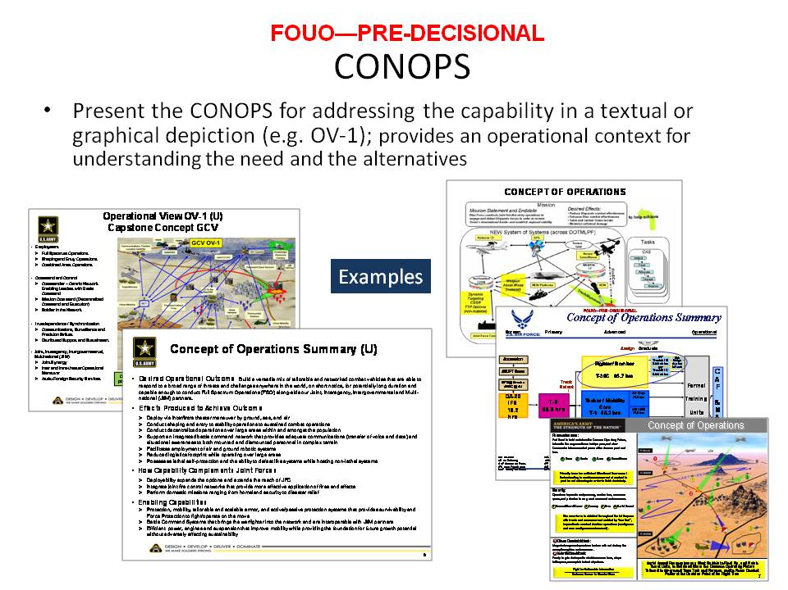
Requirements
CONOPS
Notes:
CONOPS
ICD (capability need), operational risk
Basis for determining that non-materiel solution approaches will not sufficiently mitigate the capability gap
Timeliness to capability need (near-term need and opportunities; schedule considerations)
Prioritize gaps and show gap mitigation level

Slide 5
Capability Gap &
Operational Risk of Not Filling the Gap
Describe the gap in capability and the consequences of not addressing the gap in terms of operation risk
Example
Related Operational Attributes
Capability Gap
Supporting Evidence
1
2
3
…
Prioritize the capability gaps; indicate if they need to be partially or wholly filled
JROC validated the ICD on May 2015
5
Notes:
Priorities and the degree to which gaps must be closed should be in the ICD.

Slide 6
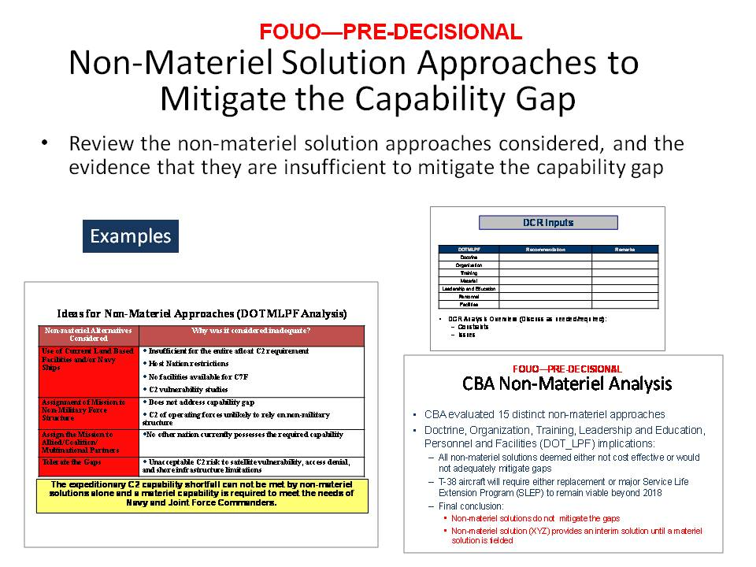
Requirements
Non-Materiel Approaches

Slide 7
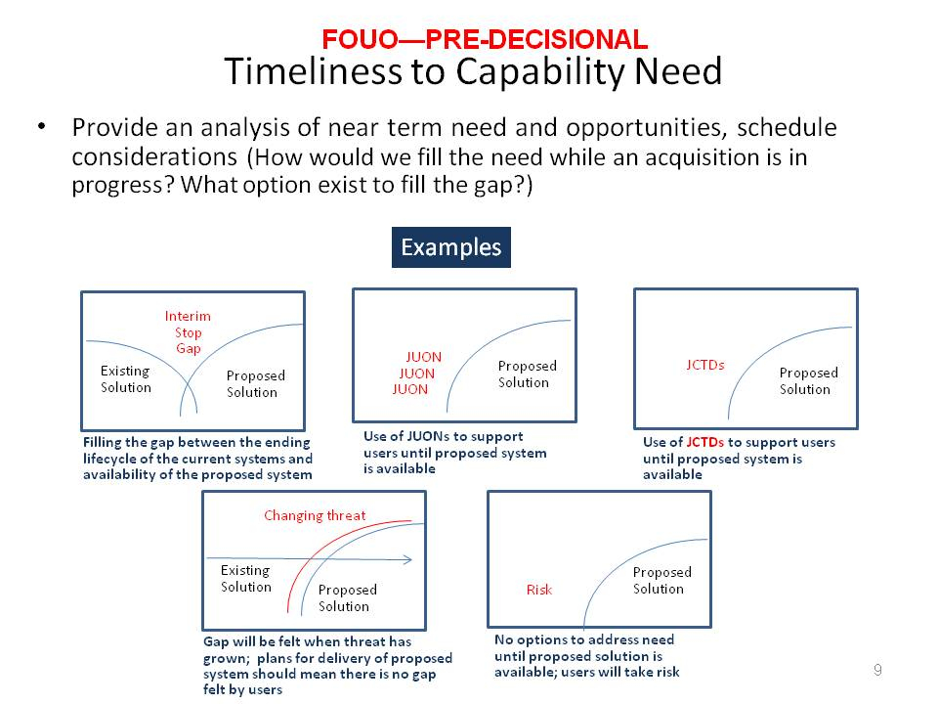
Requirements
Timeliness to Need
Provide your market research information and industry’s input

Slide 8
Suggested Materiel Solution Approaches for AoA Consideration
Summarize how well approaches that were considered adequate address the capability gaps considering JROC approved attributes and measures of effectiveness for each approach
Identify known threats that mitigate materiel approaches
Describe or illustrate the best materiel and non-materiel approaches based upon: total ownership cost, efficacy, performance, technology maturity, supportability / sustainment,
Include “no cost” approach
3 to 5 Joint system concepts (and alternative variations), that could satisfy the mission, military problem, mission tasks, operational risks and capability gaps considered in the CBA, not already addressed by currently programmed force or non-materiel solutions
Prioritized list of materiel approaches:
  Describe the non-materiel approach(es) recommended for AF or Joint DOTMLPF Change Recommendation (DCR)
  Describe the materiel approach(es) recommended for further analysis (AoA)
Notes:
Identification and scope of approaches and alternatives considered
Confidence that the selected alternatives address the gap and the desired operational attributes
Technical feasibility of the selected alternatives
External implications (portfolio implications, existing system impacts, related ICDs, additional capabilities needed to address the gap)

Slide 9
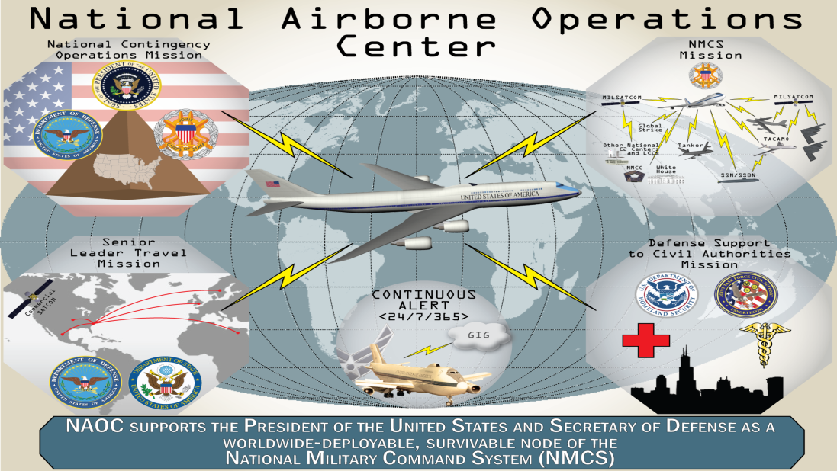
Development Planning
Concept Summary (one per CCTD*) be prepared to talk to Notes in detail
Evaluations – Identify evaluations performed and results that support this concept
Parametric studies
M&S
Prototyping (performed and planned)
Analyses
-Competitive industry concept definition studies -Concept definition results used to inform requirements trades and AoAs.
Conclusions from all evaluations
Description: Describe this concept and how it fits into the architecture
Risk Assessment: (high, medium, low):
- Operational:
- Program (cost, schedule, performance):
- Technology:
Intelligence:
Overall Risk Assessment:
Program characterization
- Cost and schedule
Design characteristics
Critical Technology Elements and maturity
- Test and Evaluation
- Operating Concept and DOT_LPF Implications
- Supportability
Notes:
*CCTD= Concept Characterization and Technical Description
Reference the Air Force Early Systems Engineering Guide and the CCTD Guide which can be found on the AF Portal at the SAF/AQR Organizational
Home Page
https://www.my.af.mil/gcssaf/USAF/ep/globalTab.do?channelPageId=s6925EC1355180FB5E044080020E329A9&command=org
Be prepared to answer the following questions:
What distinguishes this concept from others?
What is the detail of each risk? Why was it categorized H. M. or L
What is the detail of each evaluation?
Discuss required enabling capabilities – e.g., freq/spectrum rqmts, interfacing systems with planned phaseout, etc.
Be prepared to discuss affordability issues in terms of incremental approach(es), mitigating portions of the capability gap/need, etc

Slide 10
Market Research
Describe degree of industry/university involvement in early studies and research
Were requirement documents provided to industry early on to inform decisions?
How was industry input factored into requirements determination and provided to the requirements community?

Slide 11
AoA Overview
Introduction: Background, Purpose, Scope
Ground Rules: Scenarios, Threats, Environment, Constraints & Assumptions
Alternatives: Description of Alternatives, Nonviable Alternatives, Operations Concepts, Support Concepts
Determination of Effectiveness Measures: Mission Tasks, Measures of Effectiveness, Measures of Performance
Effectiveness Analysis: Effectiveness Methodology, Models, Simulations, & Data, Effectiveness Sensitivity Analysis
Cost Analysis: Life Cycle Cost Methodology, Models & Data, Cost Sensitivity &/or Risk Analysis
Cost Capability Analysis: Cost Capability Analysis Methodology, Stakeholders, Capability Tradeoff Considerations, Sensitivity Analysis
Cost-Effectiveness Comparisons: Cost-Effectiveness Methodology, Displays or Presentation Formats, Criteria for Screening Alternatives
Organization & Management: Study Team/Organization, AoA Review Process, Schedule
Focus is on Alternatives and AoA Org/Mgmt
Notes:
Another approach to present the information as outlined in the AoA section of the DAG 3.3
DAG 3.3.1 AoA Plan and Final Results https://acc.dau.mil/CommunityBrowser.aspx?id=488336
Office of Aerospace Studies (OAS) AoA Website http://www.oas.kirtland.af.mil/
Office of Aerospace Studies (OAS) AoA Handbook Jul 2008 http://www.prim.osd.mil/Documents/AoA_Handbook.pdf

Slide 12
AoA Alternatives Descriptions
Alternative 1: Develop Cutting Edge Tech Solution
Summarize Concept Characterization and Technical Description (CCTD)
Alternative 2: Modify/Upgrade the ABC Program with new capability
  Summarize CCTD
Alternative 3: Acquire COTS Product(s) and Integrate
  Summarize CCTD
AoA Study Guidance / Plan approved by DCAPE on XX
Notes:
DODI 5000.02 p. 15: The AoA shall focus on identification and analysis of alternatives, measures of effectiveness, cost, schedule, concepts of operations, and overall risk. The AoA shall assess the critical technology elements (CTEs) associated with each proposed materiel solution, including technology maturity, integration risk, manufacturing feasibility, and, where necessary, technology maturation and demonstration needs. To achieve the best possible system solution, emphasis shall be placed on innovation and competition. Existing COTS functionality and solutions drawn from a diversified range of large and small businesses shall be considered.
DAG 3.3 AoA https://akss.dau.mil/dag/Guidebook/IG_c3.3.asp
Office of Aerospace Studies (OAS) AoA Website http://www.oas.kirtland.af.mil/aoa.html
Office of Aerospace Studies (OAS) AoA Handbook Jul 2008 http://www.oas.kirtland.af.mil/AoAHandbook/AoA%20Handbook%20Final.pdf
Additional information on early systems engineering and a CCTD guide can be obtained at the SAF/AQR webpage: https://www.my.af.mil/gcss-af/USAF/ep/globalTab.do?channelPageId=s6925EC1343D70FB5E044080020E329A9

Slide 13
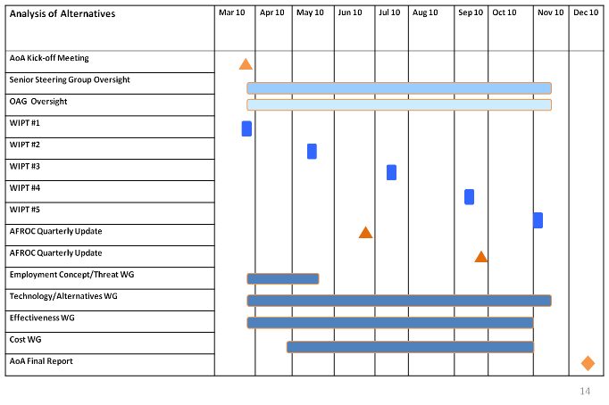
AoA Technical Synopsis
Senior Steering Group (SSG)
Office of Aerospace Studies (OAS)
Working Level Integrated Process Team (WIPT)
Study Director:
<< Name >> << Org >>
Use either schedule format
Employment Concepts Working Group (ECWG) Lead:
<< Name >> << Org >>
Technology & Alternatives Working Group (TAWG) Lead:
<< Name >> << Org >>
Effectiveness Analysis Working Group (EAWG) Lead:
<< Name >> << Org >>
Cost Analysis Working Group (CAWG)
Lead:
<< Name >> << Org >>
Identify other Service/Agency/partner participation in Working Groups
Describe models that will be used
  Highlight alignment with Joint planning scenarios

Slide 14
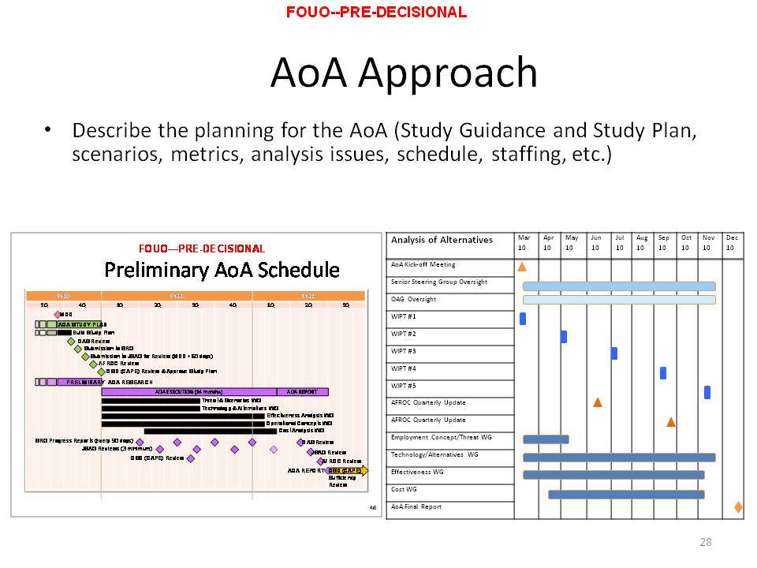
Preliminary AoA Schedule
Use either schedule format
NOTE: AFROC- and CAPE-approved AoA Study Plan is now expected at MDD

Slide 15
SAMPLE APT Framing Assumption #1
“PRE-DECISIONAL – NOT FOR RELEASE”
Purpose-built will be competitive with existing designs
Framing Assumption
Basic aircraft and training system designs will be complete through vendor-conducted CDRs
Best-value source selection must consider risk
Implications
Single step to full capability
Expectations
Enter at MS B
Limited EMD of “deltas” to meet spec
PDR and competitive prototype waivers applicable*
Contractor flight data to validate performance
Single award for EMD, Prod and ICS
RAA in 2023
FOC in 2031
*Air Force will still conduct comprehensive PDR and Critical Design Review (CDR) events post-contract award in support of Better Buying Power (BBP) 3.0 “Strengthen organic engineering capabilities” and SAF/AQ’s OTB Initiative.

Slide 16
Sample APT Framing Assumption #2
“PRE-DECISIONAL – NOT FOR RELEASE”
APT
requirements only
Framing Assumption
Mature technologies and systems available
AETC sole customer
Implications
Single step, limited EMD, waivers etc.
Separate PPBE
process for
other T-38 owners
Separate Planning Programming Budgeting and Execution (PPBE) process for APT derivative use capabilities
Expectations
IOC 2023

Slide 17
Alt Sample Framing Assumptions
Assumption* | Implications** | Expectations*** | Metric****
Design is Mature | Production concurrency possible | Schedule to IOC will be achieved | Schedule growth below historical median
Threat levels will not change much in the next 5 years | Capability changes unlikely | Costs to
Commercial demand will reduce unit cost | Production cost Est is realistic | No additional funding needed nor cost growth
See Notes pages for information
Notes:
*The PM and team should develop the programs Framing Assumption and track the validity of the FAs by assessing relevant program metrics.
**Show implications, expectations and metrics for each key framing assumption. Thee should only be a few FAs (3-5); each should have these properties, cause major consequences, have no simple work-around, be uncertain at this point, be program specific (not generic, like funding stability or good contractor performance ) and be a fundamental assumption that affect management decisions.
***Describe the visible expectations that flow from each implication of the FA.
****Specify metrics that can show whether these expectations are seen

Slide 18
Program Org Chart
Sample
OSD/AT&L
User
SAF/AQ
Depot
ACC/A5XX
Col B Martin
PEO
Lt Gen JP Jones
OO-ALC/XYZ
Col Al Griggs
PM
Col John Smith
Program
Control
Maj D. MacArthur
Contracts
Ms. Jane Smith
Sys Eng
Maj Kelly Johnson
PSM
Lt. Col T. Jones
Test
Maj C. Yeager
PC IPT
2 Captains
1 GS-12
5 Contractors
Contracts IPT
2 Captains
1 GS-12
Sys Eng IPT
2 Captains
1 GS-12
5 Contractors
Support IPT
1 Captain
1 GS-12
4 Contractors
Test IPT
2 Captains
1 GS-12
5 Contractors
Notes:
Use existing program org charts so long as they show from MDA through PM and major IPTs within the program office.
In no case shall there be more than two levels of review between the Program Manager and the Milestone Decision Authority in accordance with DODD 5000.01, DODI 5000.02, and AFPD 63/20-1.
Include in your chart the Program Control Office, if you have one.

Slide 19
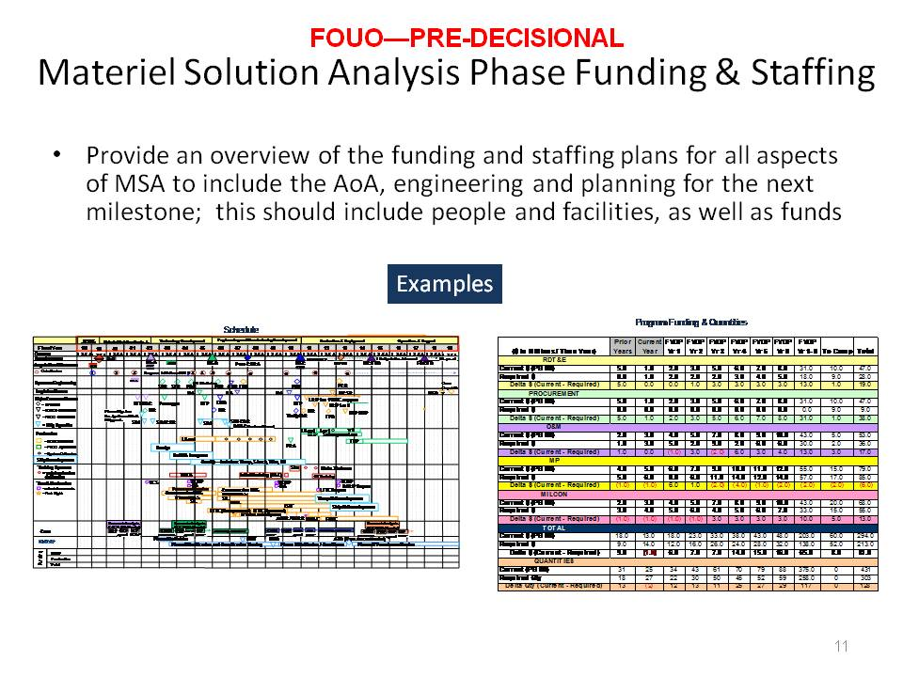
Resources for MSA

Slide 20
Affordability
MS ? Affordability Goal: ?
MS ? APB APUC Objective: ?; APB Threshold: ?
  Estimated APUC at ?
Two Affordability changes are drafted in the (Specify Milestone) ADM
  Reflect the APUC Affordability Goal at ?% above APUC objective ($?)
Are there Cost Affordability Drivers?
  If so, please explain.
Are there any disconnects throughout the lifecycle?
  How will the disconnects be addressed?
Are there any Schedule drivers impacting the Affordability Goal?
  If so, please explain.

Slide 21
Affordability Requirement
Description | Affordability Requirement (MS ? ADM) BY?? | Dec 17 SAR (In DAMIR) BY??: $? | Service Cost Position Estimate (23 Oct 18) BY??: $??
APUC (Note 1) | $? | $? | $?
O&M | $?/Unit | $?/Unit | $?/Unit
Note 1:
Quantity
APB APUC Objective $?
APB APUC Threshold $?
Notes:
Affordability Template MS C (Single Quad Chart)
Purpose: Provide the Affordability Requirements and amplify information on RDT&E and Procurement learned during design trades.
Top left quadrant: Display proposed Affordability Requirements for MDA approval. In most cases these will be the same areas used as Affordability Targets from MS A, updated to reflect the results of affordability decisions made since that time. These will be precise expressions of cost and schedule to be controlled and should have been weighed objectively for both front-end unit cost and long-term ownership cost, and be based on engineering analysis. The PM should be prepared to explain why any elements from MS A/B were not selected for MS C, or any new elements added for MS C.
Top right quadrant: Provide results of the most significant trade studies addressing Affordability Drivers. First row should be the baseline estimate of each cost element from MS A, subsequent rows should show “delta” effects of each trade study on the cost elements. The bottom row should show a current estimate, which should include but not be limited to, the info in the table. (Because not all trades can be shown in the table, the columns may not add correctly. However, if the chart shows the most significant results they should not be excessively out of line.) The current estimate should be consistent with budget information shown elsewhere in the briefing deck.
Bottom:
Discussion points.

Slide 22
Acquisition Recommendations
Recommend lead service
Recommend lead Center (PEO)
Recommend acq life cycle entry point for the program
  Include entrance criteria for next proposed milestone
    Statutory requirements
    Regulatory requirements
    Program unique requirements
  Technology maturity
  Risk summary (technical, cost, schedule)
  Demonstrate that program has met the intent of any milestone(s) to be skipped
    Show plan for compliance with statutory and regulatory requirements
    Identify phase(s) for future increment(s)

Slide 23
DoD 5000.02 Tailoring Strategy
Discuss overall 5000.02 tailoring strategy
  Is program requesting approval for specific tailoring at this meeting?
  If not, why?
Recommend area(s) that program intends to target for tailoring in future
Identify necessary dates & timelines to return for tailoring approval

Slide 24
Proposed ADM Language
(select as appropriate for effort at hand)
Program has met Entrance Criteria for MDD:
  JROC validated the xxx ICD on dd/mm/yyyy
  AoA Study Guidance / Plan approved by DCAPE
Designate USAF as Lead Component
Designate program as an ACAT IC
USAF shall prepare to return for a DAB IPR, target 1Q/FYxx
Authorize entry into the Technology Development phase, MS B target 2Q/FYyy
Prior to DAB IPR, USAF shall:
  Prepare a prototyping strategy that enables competitive prototyping
  Propose adopting a single-step-to-full-capability strategy
  Prepare preliminary Systems Engineering Plan (SEP)
  Prepare preliminary Test and Evaluation Strategy (TES)
  Submit cost estimate for recommended alternative(s) and provide the supporting full-funding profile for Technology Development

Slide 25
Summary
Requested Decision
JROC- validated requirements
AoA funding committed
Lead Service/Component (or Center/PEO) and AoA Study Team Leads established
  Screening process will provide a final set of alternatives for AoA
  FOR AFRB
Recommend concurrence with concepts for inclusion in AoA
Approve continued engagement with OSD toward MDD DAB
  FOR MDD
Recommend entry into xxx phase
Authorize Analysis of Alternatives execution
Notes:
Tailor for appropriate decision level. If continuing to OSD, request to proceed to OIPT/DAB versus approval to press forward with program execution.
Per 23 Apr OSD memo: DAB Planning Meeting 40 days ahead of MDD, OIPT 20 days, DAB Readiness Meeting 10 days – MDD submittals at 45 days to support DPM
25

Slide 26
Back-up

Slide 27
MDD – Status of Required Core Documents
REQUIREMENT | ORIGINATOR | OSD OPR | APPROVAL AUTHORITY | STATUS/COMMENTS
Affordability Analysis | AF |  | MDA
Acquisition Decision Memorandum | ARA/AM | ARA/AM | USD(AT&L)
Analysis of Alternatives Guidance | CAPE | CAPE | CAPE
Analysis of Alternatives Plan | AF | CAPE | CAPE & MDA
Initial Capabilities Document | AF | JCS/J-8 | JROC
Initial Threat Environment Assessment | AF |  | DIA Validation
Market Research | AF | DPAP | n/a
Problem Statement (DBS) | AF |  | IRB Chair
PMs will address their streamlining documentation strategy

Slide 28
Mandatory
Notes:
Notes:
+Enter values in the unshaded (white) annual and to-complete cells only. The rest of the data is calculated automatically. The spreadsheet cells will round to the nearest hundred thousand dollars ($0.1M).
+Delete any appropriation sections that have no budgeted or required costs.
+Programs must use footnotes to state source of "Required" estimate, O&S service life projection, O&S time horizon (first year of O&S – last year of O&S) & cost categories, and any RDT&E-funded quantities (if any). See Figure 1.
+Program offices are to use the latest version of the program funding template. Regularly check the Acquisition, Technology and Logistics (AT&L) Defense Acquisition Board (DAB) online calendar website (https://ebiz.acq.osd.mil/DABCalendar/) for the most current Integrated Product Team (IPT) Program Funding template. The template is updated as Programming, Planning, Budgeting, and Execution System (PPBES) events occur.
Definitions:
Primary Line Items: In the header of each section, list the primary budget line item(s) that fund the program currently and in the FYDP. For RDT&E, MILCON, and O&M, include appropriation (consistent with DAMIR reporting), budget activity and program element. For procurement, include appropriation, budget activity and line item. Some programs have smaller amounts of funding in secondary line items that need not be listed. Footnotes may be used for clarification/amplification.
Prior: President’s Budget (PB) position submitted prior to the Current budget position. Although the President only submits the FYDP to Congress, the cells for the next fiscal year and “To-Complete” should be populated for the investment appropriations using the values reported in the Selected Acquisition Report or latest DAES associated with that PB (if available).
Current: Latest approved Service POM/BES budget position or approved PB.
+During a normal PPBES cycle (PB submitted in the first Tuesday of February each year), use POM position from August through January; Use PB position from February through July.
+When the DoD Appropriation is enacted, programs should update that cell of all the "Current” PB funding and quantity rows to reflect the actual appropriated amounts.
Required: Latest estimate of funds required to successfully execute program, i.e., support the Warfighter and not simply match available budget Total Obligation Authorities (TOAs). Typically, this would reflect the Will Cost estimate, Service Cost Position (SCP), or PEO-supported Program Office Estimate (POE) that has not yet been validated by a Service Cost Agency or the CAPE. Note: total required quantity is the acquisition objective recognized by the Joint Requirements Oversight Council (JROC) or similar body and would be reflected in the program's Acquisition Program Baseline (APB) or similar document but may not be reflected in the budget due to affordability or funding issues.
System O&M: In this section, list the O&M-funded costs from initial system deployment through end of system operations. Include all costs of operating, maintaining, and supporting a fielded system. Specifically, this consists of the costs (organic and contractor) of equipment, supplies, software, and services associated with operating, modifying, maintaining, supplying, training, and supporting a system in the DoD inventory. Do not include acquisition-related O&M, and non-O&M O&S costs such as military personnel, and investment-funded system improvements. Also, do not include disposal costs, which represent a separate phase of the program life cycle. Please address questions on the O&M requirements to the OSD(AT&L)/L&MR point of contact listed below.
Total Required Acquisition (BYXX$M):
+Current Estimate of Total RDT&E, procurement, MILCON and acquisition-related O&M in base-year dollars as reported in the program's latest approved POM budget position, approved PB, or quarterly DAES submission, whichever is most current.
+The percentage displayed is the portion of the Acquisition cost out of the sum of Acquisition and O&S costs.
+Revise “BYXX$M” to reflect the 2-digit program Base Year (e.g., BY16$M). Use the Base Year specified in the current Acquisition Program Baseline (APB). For unbaselined programs (or if seeking a new or revised APB), use the budget year (e.g., BY18$M for PB18).
Total Required O&S (BYXX$M):
+Current Estimate of Total Operating and Support costs in base-year dollars as reported in the program’s quarterly DAES (if applicable). See Figure 2.
+A footnote should identify the projected service life.
+Disposal costs should not be included in this value.
+The percentage displayed is the portion of the O&S cost out of the sum of Acquisition and O&S costs. This value should not include disposal dollars.
+Revise “BYXX$M” to reflect the 2-digit program Base Year (e.g., BY16$M, IAW the instructions above for Total Required Acquisition).
Curr Est (APUC): Program Manager’s current estimate of Average Procurement Unit Cost, in base-year dollars (total procurement divided by procurement-funded quantities). The APUC should match the values reported in the program's latest approved POM/BES budget position, approved PB, or quarterly DAES submission, whichever is most current.
Curr Est (PAUC): Program Manager’s current estimate of Program Acquisition Unit Cost, in base-year dollars (total RDT&E, procurement, MILCON and acquisition-related O&M divided by total quantity). The PAUC should match the values reported in the program's latest approved POM/BES budget position, approved PB, or quarterly DAES submission, whichever is most current.
Δ Current: This is the program’s APUC or PAUC current estimate (as defined above) divided by the program’s current APB Unit Cost Reporting (UCR) baseline, as applicable. Figure 3 illustrates where this information resides in the program’s DAMIR DAES.
Δ Original: This is the program’s APUC or PAUC current estimate (as defined above) divided by the program’s original APB UCR baseline, as applicable. See Figure 3.
Points of Contact:
Army Programs:
Allen Johnson, OSD(AT&L)/ARA
allen.m.johnson44.ctr@mail.mil
703-697-5384
Navy Programs:
CDR Joseph Mitzen, OSD(AT&L)/ARA
joseph.b.mitzen.mil@mail.mil
703-697-8020
Air Force Programs:
Matthias Maier, OSD(AT&L)/ARA
matthias.r.maier.ctr@mail.mil
703-614-4030
Agency & Department-wide Programs:
Mr. Russ Vogel, OSD(AT&L)/ARA
russell.a.vogel.civ@mail.mil
703-697-1786
O&S Section:
Ms. Molly Mertz, OSD(AT&L)/L&MR
mary.m.mertz.civ@mail.mil
703-614-6137

Slide 29
Materiel Solution Approach(s)
Which Could Address the Capability Gap
Example
What material approaches ( i.e. ‘material concepts’) could address the capability gap?
What is the evidence that these approaches provide the desired operational attributes?
Which material approaches are included in the AoA guidance and/or analysis plan?
Simulation-based analysis used to validate approach
Materiel Approaches
Potential Operational Impact
Supporting Evidence
Included in AoA?
Yes
DTM 10-017
Supporting evidence (backup)

Slide 30
Alternatives Considered &
Included in the AoA
Example
What alternatives were considered for inclusion in the AoA? (Alternative ways to implement the viable approaches)
Technical Feasibility
  The basic capabilities of the alternatives has the ability to fill capability gap (mission effectiveness) and can do so within the needed timeframe
  Summarize the available evidence that the alternatives included in the AoA are technically feasible (e.g. models, analysis, prototypes, existing systems)
For each alternative, what are the implications or dependencies?
  Depending on the context this may include portfolio implications, existing system impacts, related ICDs, additional capabilities needed to address the gap
How are these dependencies factored into the planned analysis of alternatives?
Assessment of Each Alternative
DTM 10-017
Basis for assessment

Slide 31
Timeliness to Capability Need
Example
When is the capability needed?
  (Documented need date? Supporting evidence?)
When do we expect a proposed material solution be available?
  (Based on acquisition timelines of similar solutions)
If necessary, what is being done to address the gap until the material solution becomes available?
Example
Time
Operational Need Date
Projected Fielding of Material Solution
Life extension of legacy system
Different possible ways to address need until material solution becomes available
Non-Material
Actions
Change process, personnel, training …
Interim Material Solution (e.g. mod an existing system)
Rapid fielding
UON/ JCTD
Take risk
Do nothing
DTM 10-017

