Slide 1
Modernization Process Model (MPM) Revolutionary FAR Overhaul (RFO) Update Training
SAF/AQXP
Notes:
Revised Feb 2025

Slide 2
Learning Objectives
Understand FAR Overhaul Updates:
  Terminology / timelines
  MPM Updates
  DAF Contracting Compass links

Slide 3

Terminology
The MPM incorporates a variety of valuable process perspectives from over 500 sources
        150+ MPM locations/reference links updated with the following citations (IAW DAF CC):
          Federal Acquisition Regulations (RFO)
          DFARS (R-DFARS)
          DAFFARS (AFCC DAF Part#)
        Order of Precedence
DAF Contracting Compass
https://usaf.dps.mil/sites/AFCC/AQCP/KnowledgeCenter/SitePages/DAF-Contracting-Compass.aspx

Slide 4
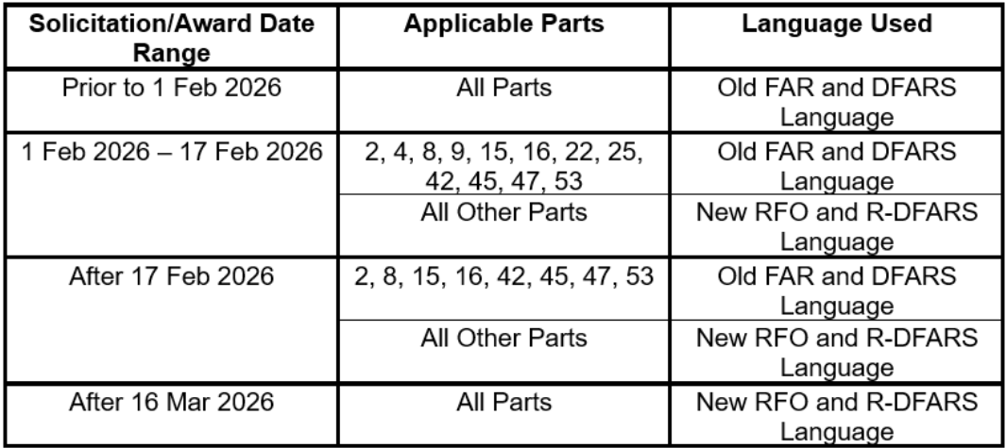
Timelines
IAW DAF Contacting Compass
  The DAF did not elect to make the changes retroactive, meaning it is CO discretion on making changes to existing solicitations, awards, including IDIQs and subsequent orders.

Slide 5
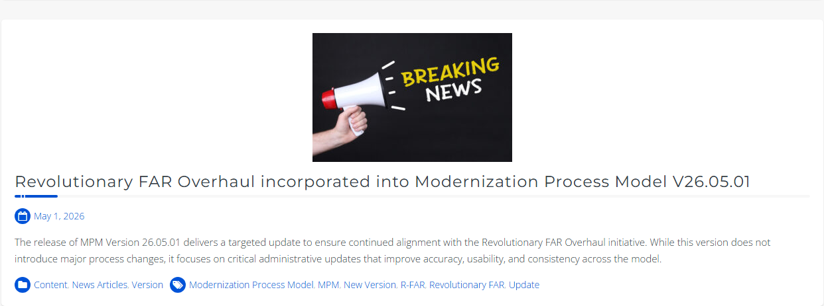
MPM Entry Screen

Slide 6
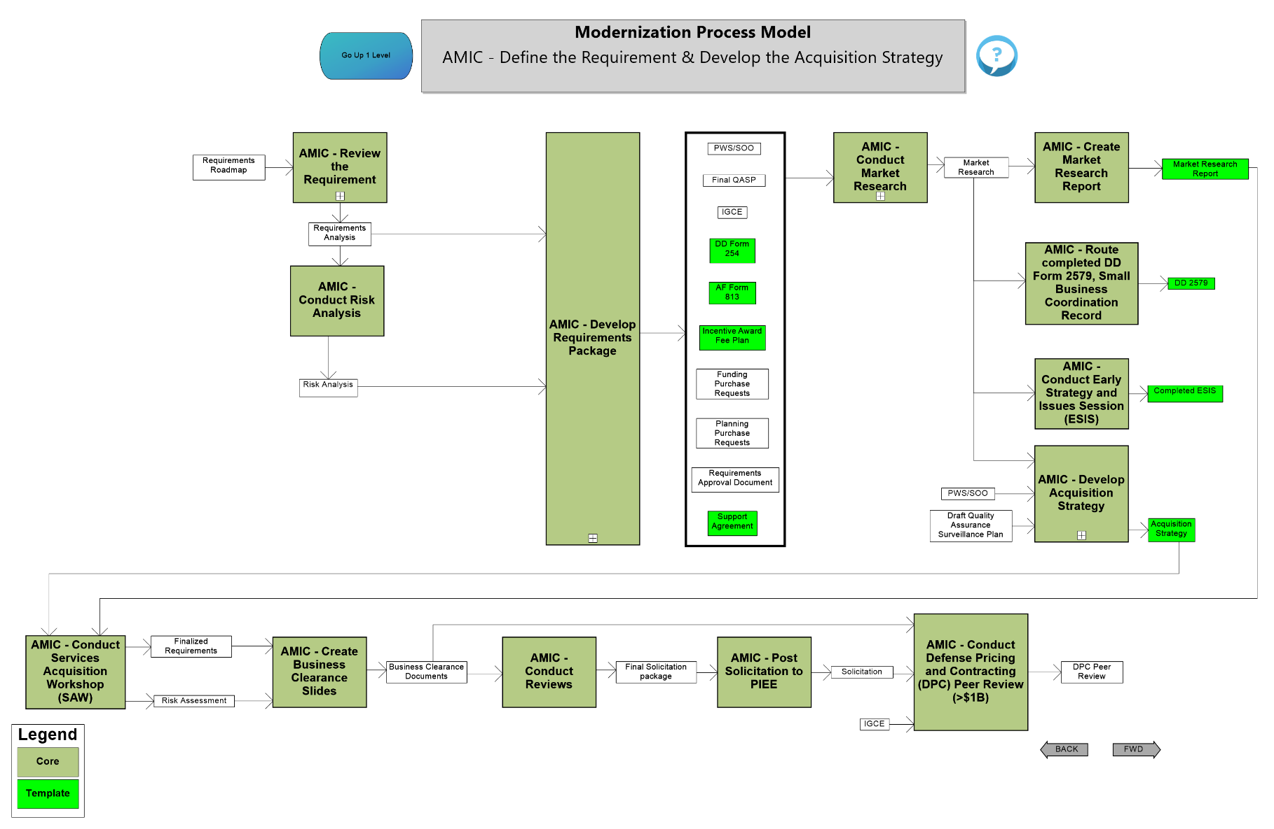
Example FAR Overhaul Process Change

Slide 7
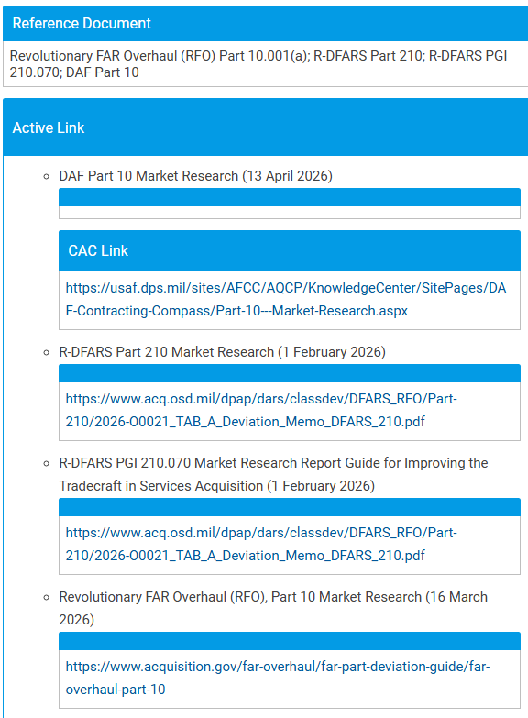
RFO, R-DFARS, and DAF Part Citations

Slide 8
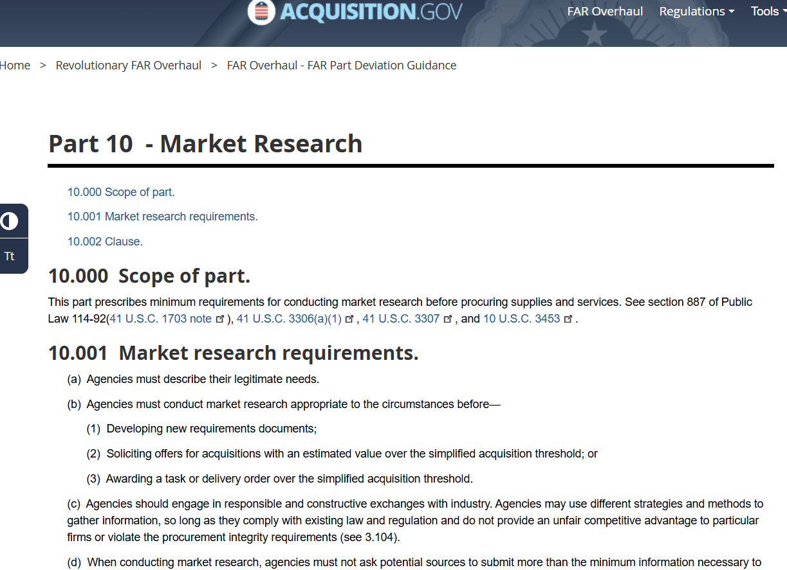
RFO Part 10 Market Research

Slide 9
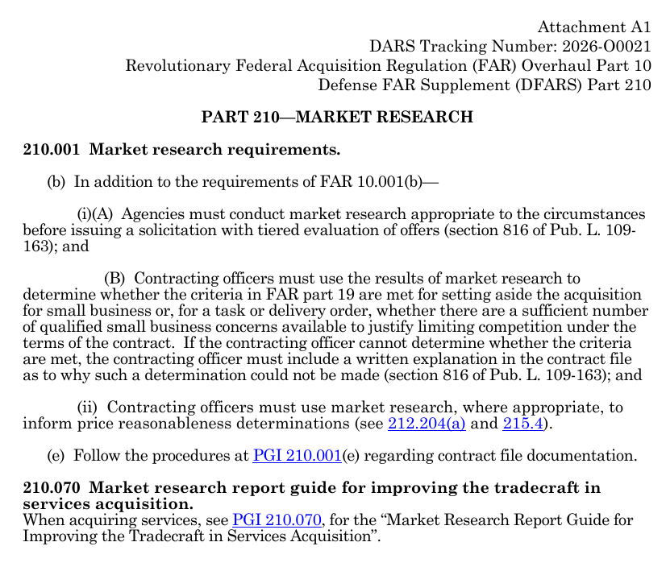
R-DFARS 210 Market Research

Slide 10
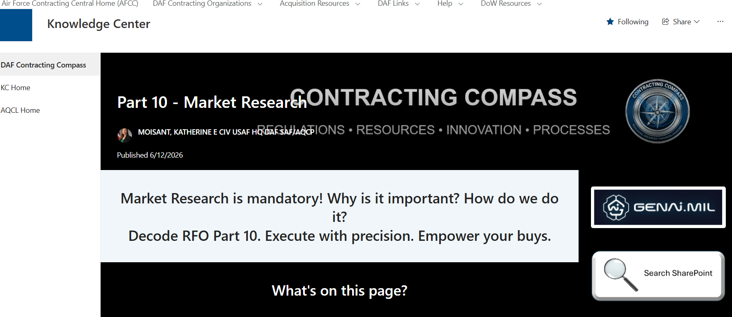
DAF Part 10 Market Research

Slide 11
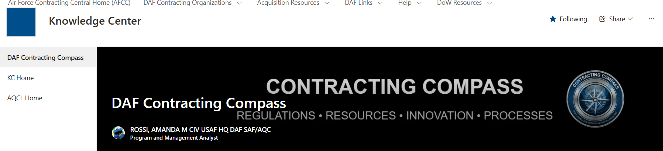
DAF Contracting Compass

Slide 12
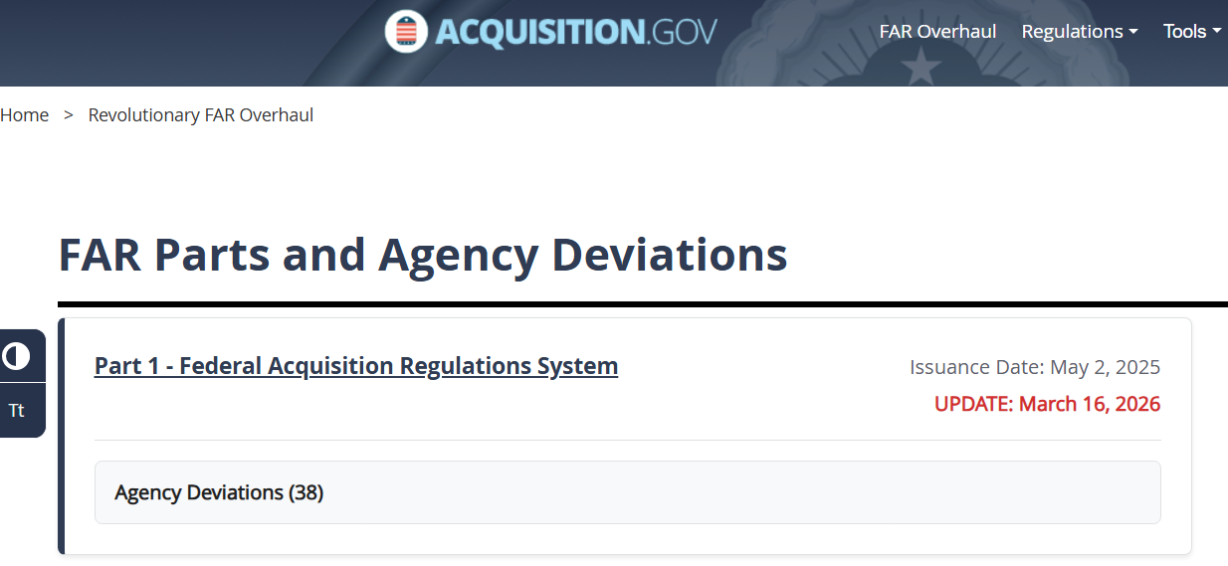
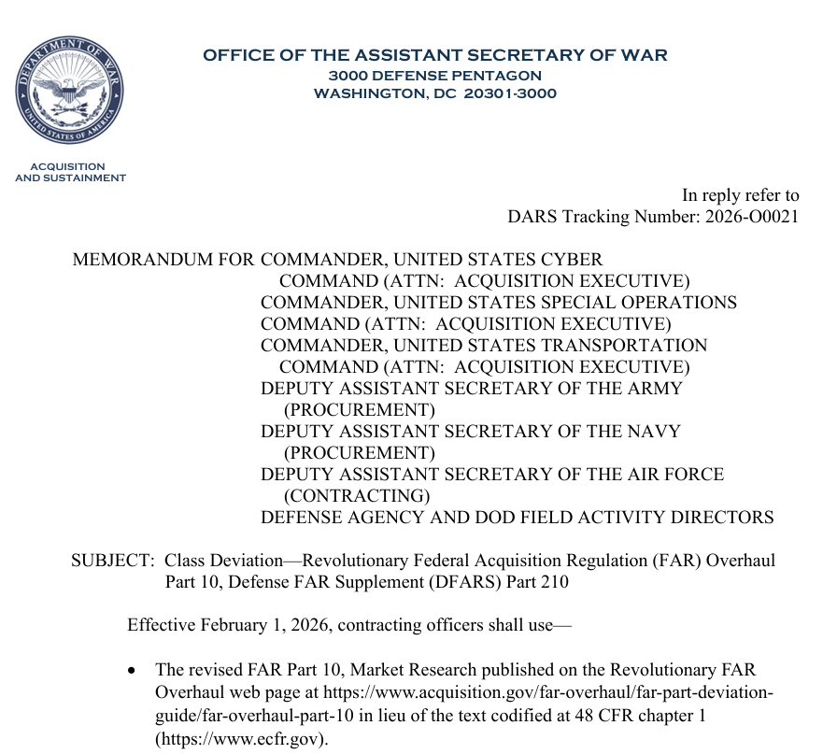
Updated Links/Websites

Slide 13
Next Steps
Update descriptions and review process impacts with subject matter experts (SMEs)
SAFAQ SharePoint (Backup MPM site)
  https://usaf.dps.mil/sites/SAFAQ/dir/integration/strategy/MPM/SitePages/Home.aspx

Slide 14
Links to Access the MPM
Direct MPM Link – afacpo.com
AF Portal – www.my.af.mil
  Search for MPM for Modernization Process Model
External Air Force Acquisition Page - ww3.safaq.hq.af.mil
  Option under the Featured Links
Common Portal Environment - https://pmrt.altess.army.mil/pmrt/login.jsp
  Links to MPM are located on ACE sites-AFLCMC, Hanscom, Hill, Robins, Space Force, and Tinker

Slide 15
Who Do I Talk To?
If you have questions, comments, or recommendations for improvements
  Contact Mr. Brad Ferguson
  brad.ferguson.2@us.af.mil
  Contact Allen Farley – (304) 216-6308 or allen.farley@sptrm.com
  Contact J.R. Dotson – (304) 641-1181 or john.dotson@sptrm.com
  Contact SAF/AQXP –
  usaf.pentagon.saf-aq.mbx.saf-aqxp-cpi-wkflw@us.af.mil

Slide 16
Backup

