Slide 1
CLASSIFICATION/FOR OFFICIAL USE ONLY/Pre-Decisional/AFRB (or DAB) Support
Milestone A Template
Program Title
Air Force Review Board (AFRB) Date
This template is for guidance only
and is not mandatory.
Examples are for illustrative purposed only
Rank, Name
Office Symbol
Date
See Notes Pages
for additional
information
CLASSIFICATION/FOR OFFICIAL USE ONLY/Pre-Decisional/AFRB (or DAB) Support
Notes:
To schedule a HQS AFRB please contact the ASP Secretariat (SAF/AQXE): Mr Stan Armstead, 571-256-1804 or Major Bryan Lowe, 571-256-0407. The earlier you request a meeting the more likely you will get the dates you need.
AS A REMINDER-- CHARTS ARE DUE TO THE SECRETARIAT 7 DAYS AHEAD OF THE BRIEFING OR THE MEETING MAY BE CANCELLED.
The purpose behind this template is to provide guidance on the issues and requirements to address at Milestone A. Each briefing will be different depending upon the nature of the program. Only brief those items that are important for the MDA to make a decision. All briefings should have less than 30 charts (not counting back-ups) to be briefed to SAF/AQ within the one hour that will be scheduled for the meeting.
If you have questions in preparing your briefing please contact your local Acquisition Center of Excellence (ACE) for guidance.
Wright Patterson AFB DSN: 785-5494/COMM: 937-255-5494
Hanscom AFB DSN: 845-1660/COMM: 781-225-1660
Eglin AFB DSN: 875-0526/COMM: 850-883-0526
Warner Robbins DSN 468-0274/COMM: 478-926-0274
Hill AFB DSN: 777-7999/COMM: 801-777-7999 or-777-5538
Tinker AFB DSN: 884-2791/COMM: 405-734-2791
Los Angeles AFB (SMC/PID) DSN: 633-1534/COMM. 310 653-1534
SAF/AQXE Commercial: 571-256-0352 (If you have recommendations for template)
Pls mark documents as follows for ACAT I programs going to OSD per OSD/GC recommendations "CLASSIFICATION/FOR OFFICIAL USE ONLY/Pre-Decisional/DAB Support."

Slide 2
Briefing Outline – Key Items
BLUF
Program Description
Analysis of Alternatives
CONOPS
Requirements
Affordability
Cost Capability Trade-offs
Schedule and Schedule Assessment
Framing Assumptions
Acquisition Strategy (including Business/Competitive Strategy)
Funding
Technology Risk and Risk Mitigation
Document Status
Recommendations for ADM (Exit Criteria)
Way Ahead
Back-up
  International Cooperation
  Other (eg., open actions from ADMs, Congressional concerns/funding cuts, industrial base issues, spectrum considerations, systems engineering assessment, logistics considerations, etc.)
Notes:
While it is not mandatory, nor possible, in one hour to address all the subjects, it is prudent to be prepared to brief or address all topics. The current AQ likes to focus on discussion of issues versus just briefing charts.

Slide 3
Bottom Line up Front
Purpose
  Present Way Ahead for Program
  Discuss oversight and management plan for Program
Decisions you are requesting (examples)
  Approval Milestone A (if AF is MDA)
  Approval to proceed to OIPT and DAB (if OSD is MDA)
  Approve Applicable delegations/waivers (e.g., competitive prototyping)
List Outstanding Issues
  Identify impacts
    XYZ Program IOC date is driving acquisition approach
    Issue #1: CAPE estimate is double current budget
  What are your concerns
    Losing Funding (for example)

Slide 4
Program Description (Quad Chart)
Sample Chart
Description
Schedule
  Mission Description:
    Xxx
    Yyy
    Zzz
  ICD Approval Date:
  AoA Completion Date
  Projected ACAT Level: ACAT ID
  Service(s): Air Force
  MDA: USD (AT&L)
  PEO: PEO XX, BG Smith
  PM: Colonel Jones
FY01 FY02 FY03 FY04 FY05 FY06 FY07 FY08
FY12 FY13 FY14 FY15 FY16 FY17 FY18 FY19
FY09 FY10 FY11 FY12 FY13
FY20 FY21 FY22 FY23 FY24
IOC
IOC
FDDR
ADM
FDDR
(Pre
ADM
(Pre
-
-
M/S B)
M/S B)
AFRB
MAIS List
AFRB
MAIS List
FOC
RIT
FOC
RIT
Annual
Annual
X
X
-
-
Plan
Plan
System/Architecture Studies
Design & Integration
System/Architecture Studies
Design & Integration
OUE
OUE
FOT&E
Test & Evaluation
FOT&E
Test & Evaluation
Procurement
Procurement
Operations & Support
Operations & Support
Approved Funding
Acquisition/Business Strategy
Actuals
PB16
  Acquisition Approach: e.g., Evolutionary Acquisition
  Competition Approach
  Contractor(s):
    Contract Type:
    Incentives:
    Share Ratio:
    (See notes)
Notes:
- 1-2 slides to provide overview of program
Program Description
Major capabilities
Graphics encouraged!
If this brief is focused on particular increment, highlight increment details
Save acquisition data for following slide
Note: For contractor, put company name followed by (P) or (S), according to whether they are the prime or a critical subcontractor. For programs with special interest by external organizations(Navy, OSD, Congress, etc.), list external orgs and area of interest.
system (photograph, system drawing, locational map, etc.) to help understand key aspect of the system.
DoDI 4650.01 page 12 covers Spectrum Supportability Risk Assessment. Consider Spectrum Supportability Risk Assessment Status:
Equipment Spectrum Certification Stage (SSRA/ESC)

Slide 5
Analysis of Alternatives
Results of Analysis of Alternatives (AoA)
    Cost Capability Tradeoffs Considered
      Show what tradeoffs between cost, schedule, and capability were evaluated during the Analysis of Alternatives that contributed to the selection of the preferred concept(s)
      Identify the primary drivers of cost, schedule and risk
Recommendations

Slide 6
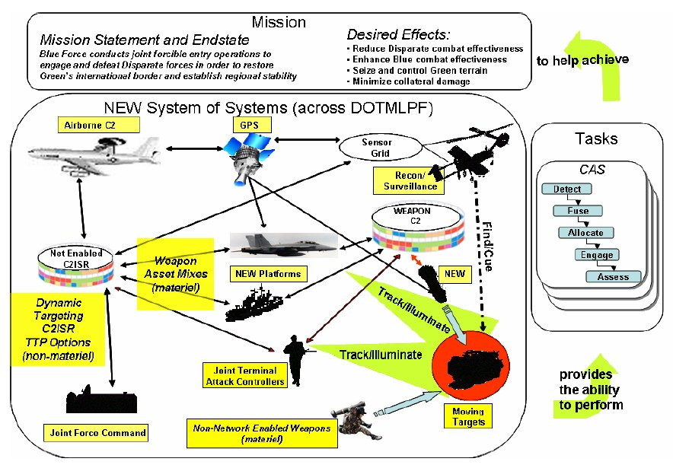
Concept of Operations

Slide 7
Requirements
Operational Requirements
  When Approved (AOA, ICD, CONOPS)
  When will final CDD be approved?
  Incremental Requirements?
    How are increments addressed in the CDD?
    EMD phase for each increment planned for 5 years or less?
    How will program achieve information assurance requirements? (see footnotes)
  How does the program baseline compare to validated requirements?
Operational Capabilities/Impacts
  Capabilities / missions (today & future)
    Relationship to established roadmap(s) / architecture(s)
    Family of Systems (FOS) / System of Systems (SOS) / Complementary Systems
      Example for E-10A: MP-RTIP, Global Hawk, MP-CDL, Army CGS
Notes:
Information Assurance requirements--are particularly import for Command, Control, Communications, Computers, Intelligence, Surveillance, and Reconnaissance systems; and information technology programs that depend on external information sources or provide information to other DoD systems.

Slide 8
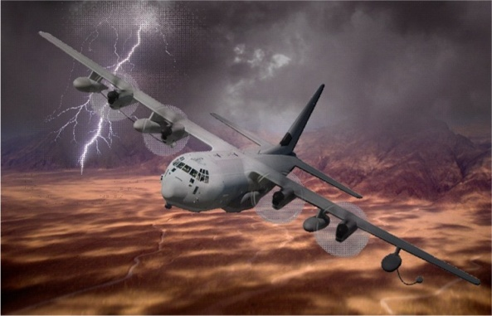
Interrelationships, Dependencies and Synchronization with Complementary Systems
Aviation Platforms:
KC-135
KC-10
AWACS
H/MH-60
CV-22
MH-47
MH-6
CH-53
A/OA-10
HC/MC-130 Recap
Mission Planning
PFPS
JMPS
Ground Teams:
GAWS
SF
SEAL
STS
C-130J:
Aircraft Procurement
& Block Upgrades
LAIRCM
Solid denotes current system
Dash denotes future system
Arrow to Recap denotes supports Recap
Arrow from Recap denotes Recap supports
Indicates program are interdependent
No known issues affecting inter-related programs
Resolvable interface issues affecting programs
Unresolvable interface issues affecting programs
Notes:
Purpose:
Very few programs today operate or function independently. Most programs are affected by other components and systems, and it usually takes a combination of programs to accomplish the full effects of a weapon or communication system. The Program Manager of the reviewed program is the best source of information on which programs/systems the reviewed program depends upon either operationally (supports other weapon systems), physically (embedded components) or systemically (communications or digital links).
Business Rules:
a. Programs to Include:
The reviewed program is in the center of the chart with any crucial interrelated programs, including communication links and cyber infrastructure, listed with arrowheads denoting the direction of dependency. Crucial interdependencies are such that the program under review cannot achieve capabilities articulated in the CONOPs, CDD, or CPD (as appropriate) without the related capability provided by this program. Two way dependencies will have a double-headed arrow. Program groupings, where possible, should be by mission or capability area vice platform type. Include programs currently in development.
b. Availability:
Indicate whether the deliverables from one program to the other are on track, both in quantity and in schedule. If either of the interrelated programs are at risk of missing giver-receiver dates, color the interdependency arrow red or yellow for the appropriate severity. Be prepared to discuss reason for delay, impact, and mitigation.
c. Interoperability:
Indicate whether the technical performance requirements are being met by the interrelated programs such that they will be able to integrate and function together. Assess both hardware and software/data interoperability. If there is a risk or issue affecting the interoperability of the systems, color the interdependency line red or yellow for the appropriate severity. Be prepared to discuss interoperability issues, impact, and mitigation.
d. Security:
While systems may be available and interoperable, there may exist security risks to the Reviewed program or due to the interconnection with the crucial interrelated programs identified. Consider all areas of security that result in overall mission risk, including: Personnel Security, Physical Security, Software Assurance, Cybersecurity, Supply Chain Risk Management, Anti-Tamper, Industrial Security, Operations Security, and Communications Security. Color the interdependency line green, yellow or red for the appropriate risk level. Be prepared to discuss moderate/high risks, impact, and mitigation.

Slide 9
Affordability
MS ? Affordability Goal: ?
MS ? APB APUC Objective: ?; APB Threshold: ?
  Estimated APUC at ?
Two Affordability changes are drafted in the (Specify Milestone) ADM
  Reflect the APUC Affordability Goal at ?% above APUC objective ($?)
Are there Cost Affordability Drivers?
  If so, please explain.
Are there any disconnects throughout the lifecycle?
  How will the disconnects be addressed?
Are there any Schedule drivers impacting the Affordability Goal?
  If so, please explain.

Slide 10
Affordability Requirement
Description | Affordability Requirement (MS ? ADM) BY?? | Dec 17 SAR (In DAMIR) BY??: $? | Service Cost Position Estimate (23 Oct 18) BY??: $??
APUC (Note 1) | $? | $? | $?
O&M | $?/Unit | $?/Unit | $?/Unit
Note 1:
Quantity
APB APUC Objective $?
APB APUC Threshold $?
Notes:
Affordability Template MS C (Single Quad Chart)
Purpose: Provide the Affordability Requirements and amplify information on RDT&E and Procurement learned during design trades.
Top left quadrant: Display proposed Affordability Requirements for MDA approval. In most cases these will be the same areas used as Affordability Targets from MS A, updated to reflect the results of affordability decisions made since that time. These will be precise expressions of cost and schedule to be controlled and should have been weighed objectively for both front-end unit cost and long-term ownership cost, and be based on engineering analysis. The PM should be prepared to explain why any elements from MS A/B were not selected for MS C, or any new elements added for MS C.
Top right quadrant: Provide results of the most significant trade studies addressing Affordability Drivers. First row should be the baseline estimate of each cost element from MS A, subsequent rows should show “delta” effects of each trade study on the cost elements. The bottom row should show a current estimate, which should include but not be limited to, the info in the table. (Because not all trades can be shown in the table, the columns may not add correctly. However, if the chart shows the most significant results they should not be excessively out of line.) The current estimate should be consistent with budget information shown elsewhere in the briefing deck.
Bottom:
Discussion points.

Slide 11
Milestone A
Cost Capability Analysis (CCA)
Discuss how proposed TMRR strategy will refine operational requirements to identify opportunities to reduce costs
  Discuss the plan for conducting CCA during TMRR phase to identify opportunities to trade off operational capabilities
    Which requirements are the most costly and/or risky?
    Which requirements could result in cost savings, if adjusted?
    Where is the knee in the cost capability “curve” for the most costly or risky requirements?
    How do you plan to engage with industry to get their understanding of how requirements might be traded off to make the program more affordable?
    What requirements are your cost drivers in your design concept?
    Are the largest drivers related to technical, schedule, or other factors?
    Address how KPPs will influence your pre-MS B decision making
  What is program strategy to obtain industry input on draft CDD & EMD RFP
Notes:
Cost Capability Analysis is used to refine operational requirements in the draft CDD leading to a validated CDD and is required to be reported at acquisition and requirements forums IAW AFI 10-601 and AFI 63-101. See backup slide for example trades worksheet.

Slide 12
Program Schedule
(include schedule assessment)
ICD
FY25
FY12
FY13
FY14
FY15
FY16
FY17
FY18
FY19
FY20
FY21
FY22
FY23
FY24
Program
Milestones
MS A / DAE
Review
Dev RFP Review
Post-PDR
Assessment
Post-CDR
Assessment
DAB
Review
MS B
MS C
Requirements
Concept Studies Contracts (3 contractors)
Contract Award
PMR
Contract Award
PMR
Contract Award
PMR
SRR
SFR
PDR/TDR
TRA
TRL 6
OT&E Operation Test and Evaluation
PDR Preliminary Design Review
RFI Request for Information
SFR System Functional Review
SRR System Readiness Review
SW Software
TDR Technology Demonstration Review
TRA Technology Readiness Assessment
TRR Test Readiness Review
TD Contracts (up to 3 contractors)
Contract Award
CDR Critical Design Review
DAB Defense Acquisition Board
DAE Defense Acquisition Executive
EDM Engineering Development Model
HW Hardware
IOC Initial Operating Capability
IPR In-Process Review
LRIP Low-Rate Initial Production
PMR Program Management Review
PR Program Review
Contract Award
SRR
SFR
PDR/TDR
TRA
TRL 6
Contract Award
SRR
SFR
PDR/TDR
TRA
TRL6
Contract Award
Complete
Planned
EMD Contract
(1 contractor)
SW/System
Δ PDR
HW Δ PDR
SW/System
CDR
Integration
& Test
EMD Contract
(1 contractor)
RFI
Assessment
Complete
Contract Award
HW CDR
Engineering Studies
IOT&E*
Production Contract
LRIP
LRIP Prod
Program Phases
Concept Studies
Technology Development
Engineering and Manufacturing Development
Production and Deployment

Slide 13
Program Schedule Assessment
Identify Major Schedule Drivers:
What technical issues pace the project?
Does your IOC date drive an unrealistic schedule?
Are we trying to beat someone in this competitive space, and what’s the likelihood for doing so?

Slide 14
SAMPLE APT Framing Assumption #1
“PRE-DECISIONAL – NOT FOR RELEASE”
Purpose-built will be competitive with existing designs
Framing Assumption
Basic aircraft and training system designs will be complete through vendor-conducted CDRs
Best-value source selection must consider risk
Implications
Single step to full capability
Expectations
Enter at MS B
Limited EMD of “deltas” to meet spec
PDR and competitive prototype waivers applicable*
Contractor flight data to validate performance
Single award for EMD, Prod and ICS
RAA in 2023
FOC in 2031
*Air Force will still conduct comprehensive PDR and Critical Design Review (CDR) events post-contract award in support of Better Buying Power (BBP) 3.0 “Strengthen organic engineering capabilities” and SAF/AQ’s OTB Initiative.

Slide 15
Sample APT Framing Assumption #2
“PRE-DECISIONAL – NOT FOR RELEASE”
APT
requirements only
Framing Assumption
Mature technologies and systems available
AETC sole customer
Implications
Single step, limited EMD, waivers etc.
Separate PPBE
process for
other T-38 owners
Separate Planning Programming Budgeting and Execution (PPBE) process for APT derivative use capabilities
Expectations
IOC 2023

Slide 16
Alt Sample Framing Assumptions
Assumption* | Implications** | Expectations*** | Metric****
Design is Mature | Production concurrency possible | Schedule to IOC will be achieved | Schedule growth below historical median
Threat levels will not change much in the next 5 years | Capability changes unlikely | Costs to
Commercial demand will reduce unit cost | Production cost Est is realistic | No additional funding needed nor cost growth
See Notes pages for information
Notes:
*The PM and team should develop the programs Framing Assumption and track the validity of the FAs by assessing relevant program metrics.
**Show implications, expectations and metrics for each key framing assumption. Thee should only be a few FAs (3-5); each should have these properties, cause major consequences, have no simple work-around, be uncertain at this point, be program specific (not generic, lie funding stability or good contractor performance ) and be a fundamental assumption that affect management decisions.
***Describe the visible expectations that flow from each implication of the FA.
****Specify metrics that can show whether these expectations are seen

Slide 17
Program Org Chart
Sample
OSD/AT&L
User
SAF/AQ
Depot
ACC/A5XX
Col B Martin
PEO
Lt Gen JP Jones
OO-ALC/XYZ
Col Al Griggs
PM
Col John Smith
Program
Control
Maj D. MacArthur
Contracts
Ms. Jane Smith
Sys Eng
Maj Kelly Johnson
PSM
Lt. Col T. Jones
Test
Maj C. Yeager
PC IPT
2 Captains
1 GS-12
5 Contractors
Contracts IPT
2 Captains
1 GS-12
Sys Eng IPT
2 Captains
1 GS-12
5 Contractors
Support IPT
1 Captain
1 GS-12
4 Contractors
Test IPT
2 Captains
1 GS-12
5 Contractors
Notes:
Use existing program org charts so long as they show from MDA through PM and major IPTs within the program office.
In no case shall there be more than two levels of review between the Program Manager and the Milestone Decision Authority in accordance with DODD 5000.01, DODI 5000.02, and AFPD 63/20-1.
Include in your chart the Program Control Office, if you have one.

Slide 18
Business Strategy
Competition Strategy
  How will competition be established and maintained through all phases of the acquisition (to include spares and depot repair)?
  How does the competition strategy facilitate the acquisition strategy ?
  What is the competition strategy for the upcoming acquisition phase?
  How do the results of the last acquisition phase impact the strategy for the upcoming phase?
  Identify barriers (requirements changes, schedule, cost (funding)) to competition and mitigation strategies
  Discuss strategy for implementing open systems architecture and acquiring intellectual property rights (including SW)
  MOSA
  For Each Contract
  What is the purpose, type and value of the contract (s)?
  How is the contract aligned with the acquisition and competition strategies?
  What is the incentive structure and how will the incentives foster contractor behavior resulting in favorable cost, schedule and performance outcomes?
  What criteria will be used to select the winning bidder? How do those criteria emphasize what is most important to the government?
  Will warranties be employed? How will they benefit the government?
  Does the contract anticipate the acquisition of technical data?
  Any special contract issues?
  MOSA

Slide 19
DoD 5000.02 Tailoring Strategy
Discuss overall 5000.02 tailoring strategy
  Is program requesting approval for specific tailoring at this meeting?
  If not, why?
Discuss areas that have been tailored previously
Recommend area(s) that program intends to target for tailoring in future
Identify necessary dates & timelines to return for tailoring approval

Slide 20

Program Funding
Notes:
Notes:
+Enter values in the unshaded (white) annual and to-complete cells only. The rest of the data is calculated automatically. The spreadsheet cells will round to the nearest hundred thousand dollars ($0.1M).
+Delete any appropriation sections that have no budgeted or required costs.
+Programs must use footnotes to state source of "Required" estimate, O&S service life projection, O&S time horizon (first year of O&S – last year of O&S) & cost categories, and any RDT&E-funded quantities (if any). See Figure 1.
+Program offices are to use the latest version of the program funding template. Regularly check the Acquisition, Technology and Logistics (AT&L) Defense Acquisition Board (DAB) online calendar website (https://ebiz.acq.osd.mil/DABCalendar/) for the most current Integrated Product Team (IPT) Program Funding template. The template is updated as Programming, Planning, Budgeting, and Execution System (PPBES) events occur.
Definitions:
Primary Line Items: In the header of each section, list the primary budget line item(s) that fund the program currently and in the FYDP. For RDT&E, MILCON, and O&M, include appropriation (consistent with DAMIR reporting), budget activity and program element. For procurement, include appropriation, budget activity and line item. Some programs have smaller amounts of funding in secondary line items that need not be listed. Footnotes may be used for clarification/amplification.
Prior: President’s Budget (PB) position submitted prior to the Current budget position. Although the President only submits the FYDP to Congress, the cells for the next fiscal year and “To-Complete” should be populated for the investment appropriations using the values reported in the Selected Acquisition Report or latest DAES associated with that PB (if available).
Current: Latest approved Service POM/BES budget position or approved PB.
+During a normal PPBES cycle (PB submitted in the first Tuesday of February each year), use POM position from August through January; Use PB position from February through July.
+When the DoD Appropriation is enacted, programs should update that cell of all the "Current” PB funding and quantity rows to reflect the actual appropriated amounts.
Required: Latest estimate of funds required to successfully execute program, i.e., support the Warfighter and not simply match available budget Total Obligation Authorities (TOAs). Typically, this would reflect the Will Cost estimate, Service Cost Position (SCP), or PEO-supported Program Office Estimate (POE) that has not yet been validated by a Service Cost Agency or the CAPE. Note: total required quantity is the acquisition objective recognized by the Joint Requirements Oversight Council (JROC) or similar body and would be reflected in the program's Acquisition Program Baseline (APB) or similar document but may not be reflected in the budget due to affordability or funding issues.
System O&M: In this section, list the O&M-funded costs from initial system deployment through end of system operations. Include all costs of operating, maintaining, and supporting a fielded system. Specifically, this consists of the costs (organic and contractor) of equipment, supplies, software, and services associated with operating, modifying, maintaining, supplying, training, and supporting a system in the DoD inventory. Do not include acquisition-related O&M, and non-O&M O&S costs such as military personnel, and investment-funded system improvements. Also, do not include disposal costs, which represent a separate phase of the program life cycle. Please address questions on the O&M requirements to the OSD(AT&L)/L&MR point of contact listed below.
Total Required Acquisition (BYXX$M):
+Current Estimate of Total RDT&E, procurement, MILCON and acquisition-related O&M in base-year dollars as reported in the program's latest approved POM budget position, approved PB, or quarterly DAES submission, whichever is most current.
+The percentage displayed is the portion of the Acquisition cost out of the sum of Acquisition and O&S costs.
+Revise “BYXX$M” to reflect the 2-digit program Base Year (e.g., BY16$M). Use the Base Year specified in the current Acquisition Program Baseline (APB). For unbaselined programs (or if seeking a new or revised APB), use the budget year (e.g., BY18$M for PB18).
Total Required O&S (BYXX$M):
+Current Estimate of Total Operating and Support costs in base-year dollars as reported in the program’s quarterly DAES (if applicable). See Figure 2.
+A footnote should identify the projected service life.
+Disposal costs should not be included in this value.
+The percentage displayed is the portion of the O&S cost out of the sum of Acquisition and O&S costs. This value should not include disposal dollars.
+Revise “BYXX$M” to reflect the 2-digit program Base Year (e.g., BY16$M, IAW the instructions above for Total Required Acquisition).
Curr Est (APUC): Program Manager’s current estimate of Average Procurement Unit Cost, in base-year dollars (total procurement divided by procurement-funded quantities). The APUC should match the values reported in the program's latest approved POM/BES budget position, approved PB, or quarterly DAES submission, whichever is most current.
Curr Est (PAUC): Program Manager’s current estimate of Program Acquisition Unit Cost, in base-year dollars (total RDT&E, procurement, MILCON and acquisition-related O&M divided by total quantity). The PAUC should match the values reported in the program's latest approved POM/BES budget position, approved PB, or quarterly DAES submission, whichever is most current.
Δ Current: This is the program’s APUC or PAUC current estimate (as defined above) divided by the program’s current APB Unit Cost Reporting (UCR) baseline, as applicable. Figure 3 illustrates where this information resides in the program’s DAMIR DAES.
Δ Original: This is the program’s APUC or PAUC current estimate (as defined above) divided by the program’s original APB UCR baseline, as applicable. See Figure 3.
Points of Contact:
Army Programs:
Allen Johnson, OSD(AT&L)/ARA
allen.m.johnson44.ctr@mail.mil
703-697-5384
Navy Programs:
CDR Joseph Mitzen, OSD(AT&L)/ARA
joseph.b.mitzen.mil@mail.mil
703-697-8020
Air Force Programs:
Matthias Maier, OSD(AT&L)/ARA
matthias.r.maier.ctr@mail.mil
703-614-4030
Agency & Department-wide Programs:
Mr. Russ Vogel, OSD(AT&L)/ARA
russell.a.vogel.civ@mail.mil
703-697-1786
O&S Section:
Ms. Molly Mertz, OSD(AT&L)/L&MR
mary.m.mertz.civ@mail.mil
703-614-6137

Slide 21
Technology Risk
Ship Integration (P, C, S)
If radar exceeds allowable HM&E constraints, then radar or ship systems will require re-design and increased cost.
P: Technical Performance
C: Cost
S: Schedule
Large Aperture Digital Beam Forming (C,P)
If the large distributed digital beamforming subsystem required for AMDR does not meet multi-beam quality, dynamic range and phase noise requirements, then operational performance will be adversely impacted and may increase system cost.
TR Module Performance (C,P)
If the Transmit/Receive (T/R) Module cannot support the required transmit power, pulse width and efficiency, then allocated shipboard power supply will be exceeded or radar sensitivity performance will not be met.
1000 Element Prototype Test (S)
If the 1000 element array development can not be accomplished within the Technology Development Phase time frame, then TRA and demonstration of TRL-6 will be delayed.
Likelihood
Thermal Management/Cooling (P)
If allocated Transmit/Receive (T/R) module baseplate temperatures are not achieved, and array thermal gradients managed, then array angle accuracy and reliability requirements will not be met.
Software Architecture (S)
If the AMDR software development approach and architecture is not properly designed and developed, development and testing will be delayed.
Consequence
Array Flatness and Stiffness (P)
If requisite array flatness and stiffness are not achieved, then beam pointing accuracy and sensor handover requirements will not be met.
Spectrum Allocation (C, P)
If required spectrum is not available, then operational performance and/or tactical procedures may be adversely impacted.
Radar Resource Management (P)
If AMDR resources are not properly managed, especially during BMD, then unnecessary limitations on resources available for performance of simultaneous missions will result in performance in one or more mission areas that will not meet requirements.
AMDR Integration (S)
If interface definitions for AMDR-S, AMDR-X, RSC and Combat System are not properly designed and developed, then radar and combat system overall development schedules will be delayed.

Slide 22
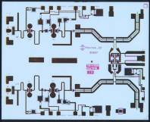
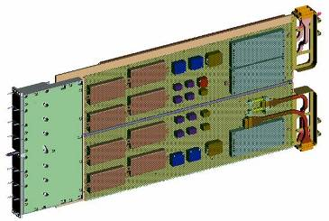
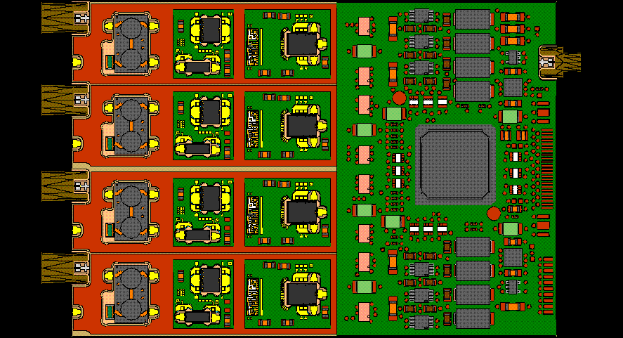
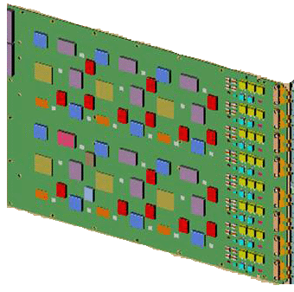
Critical Technologies
Active Array
Physical Architectures
& Scalability
High Power Amplifiers (HPA) and
T/R Modules & Power Supplies
Power Supply
HPA MMIC
LRU
(100+sub-arrays)
T/R Modules
Array
Large Aperture Digital Beamforming (DBF)
And Calibration
Distributed
Receivers/Exciters
(DREX)
Digital
Beamformer
Signal & Data Processor
Receiver/Exciters
Multi-beam Signal Processing Software
Multi-mission Scheduling & Discrimination Software
(100+ channels)
20

Slide 23
Technology Readiness
Sample Chart
Critical Technology Element | TRL | Incr 1 | Incr 2
 | 9 | X
 | 6 |  | X
 | 9 | X
 | 8 | X
 | 9 | X
 | 9 | X
 | 7 |  | X
 | 5 |  | X
 | 6 |  | X
 | 6 |  | X
 | 9 | X
 | 6 | X
 | 9 | X
 | 8 | X
 | 8 | X
See Notes Page
Notes:
List key program technologies; current TRLs. TRL 6 is required by MS B. If a technology is below TRL 6 summarize the technology maturation approach (pre-MS A) or summarize the verification of the technology maturation (pre-MS B/C)
List TRL level for critical technologies which may impact meeting a KPP , KSA or APA thresholds or represent risk to deliver capability on schedule and budget
Recommend explaining maturity plans for any CTEs that are not at the requisite level when the review takes place (i.e. TRL 6 at MS B, TRL 7 at MS C).
The category of Technology identifies the key technologies necessary for this program. Column 2 the TRL and the next two columns in this sample (showing two increments) provides the increment in which the technology will be delivered.
This sample generally applies to hardware
Additionally you may want to utilize the Technology Development and Transition Strategy (TDTS) Guidebook, which can be found at the DAU website.
(See OSD AS Template para 6.3)

Slide 24
Technology Maturation
System Demonstration
in Actual Environment
7
System Demonstration in
Operational Environment
6
EMD Phase
TRL 7
EDM Testing
Technology Readiness Level (TRL)
System Demonstration in
a Relevant Environment
5
ARTIST Advanced Radar Technology Integrated System Testbed AUSPAR Australia U.S. Phased Array Radar
DAR Digital Array Radar
DBF Digital Beamforming
DREX Distributed Receiver/Exciter EDM Engineering Development Model
JUSRR Japan/U.S. Radar Research
LRU Lowest Replaceable Unit
ONR Office of Naval Research
SR3 S-Band Radar Risk Reduction
T/R Transmit Receive
TRA Technology Readiness Assessment
TRL Technology Readiness Level
TD Phase
AMDR Prototyping
TRL 6
Component/Subsystem
Demonstrations
4
Pre-MSA
V7 2010-06-29
Risk Reduction Efforts
TRL 3-5
Early
Technology
Readiness
Assessment
MS A
MS B
MS C
TRA
FY07
FY08
FY09
FY10
FY11
FY12
FY13
FY14
FY15
FY16
FY17
See Notes Page
Notes:
24
Air Force Preference is the program will achieve a TRL 6 prior to beginning of the PDR phase.

Slide 25
MS A Document Status
Documentation | S/R* | Status | Comments
2366a Certification | S | In OSD Coord
Acquisition Decision Memorandum (ADM) | R | In draft form
Acquisition Strategy | S/R | In-Work
Affordability Analysis |  | Complete
Analysis of Alternatives (AoA) | S | Complete
Capability Development Document (CDD) | R | In-work | .
Clinger-Cohen Act Compliance | S | In-work
Concept of Operations/ Operational Mode Summary/ Mission Profile | R | Complete
Cost Analysis Requirements Document | R | Complete
Component Cost Estimate | R | Complete
Component Cost Position | R | Complete
PMs will address their streamlining documentation strategy
* S=Statutory, R=Regulatory
Complete | On-Track | Minor Issues | Major Issues

Slide 26
MS A Document Status
Documentation | S/R* | Status | Comments
Economic Analysis | S | In OSD Coord
Exit Criteria | R | In draft form
Frequency Allocation Application (DD Form 1494) | S | In-Work
Full Funding Certification Memo | R | In-work | FMB will coordinate by next Monday
Independent Cost Estimate | S | In work
Life Cycle Mission Data Plan | R | In-work | .
Life Cycle Sustainment Plan Cyber Security Plan | R | In-work
Program Certification for DBS Mgt Committee | S | Complete
Program Protection Planning Cybersecurity Strategy | R | Complete
Replaced System Sustainment Plan | S | Complete
Request for Proposal | R | Complete
PMs will address their streamlining documentation strategy
* S=Statutory, R=Regulatory
Complete | On-Track | Minor Issues | Major Issues

Slide 27
MS A Document Status
Documentation | S/R* | Status | Comments
Spectrum Supportability Risk Assessment | R | In draft form
System Threat Assessment Report (STAR) | R | In-Work
System Engineering Plan IUID Implementation Plan | R | Complete
Technology Targeting Risk Assessment | R | In work
Test and Evaluation Master Plan (TEMP | R | In-work | .
PMs will address their streamlining documentation strategy
* S=Statutory, R=Regulatory
Complete | On-Track | Minor Issues | Major Issues

Slide 28
ADM Language
Proposed Acquisition Decision Memorandum (ADM) language:
I have made the certifications required by section 2366a of title 10, United States Code (see footnotes)
I approve MS A and authorize entrance into Technology Maturation and Risk Reduction
Recommended TMRR Exit Criteria
  XXX
  YYY
  ZZZ
Recommended 'Affordability Goals' for average procurement cost and for operating and support cost
Notes:
2366A certifications: a) Certification.— A major defense acquisition program may not receive Milestone A approval…until the MDA certifies, after consultation with the JROC on matters related to program requirements and military needs— (1) that the program fulfills an approved initial capabilities document;
(2) that the program is being executed by an entity with a relevant function as identified by the Secretary of Defense under section 118b of this title;
(3) if the program duplicates a capability already provided by an existing system, the duplication provided by such program is necessary and appropriate;
(4) that a determination of applicability of core logistics capabilities requirements has been made;
(5) that an analysis of alternatives has been performed consistent with study guidance developed by the Director of Cost Assessment and Program Evaluation; and
(6) that a cost estimate for the program has been submitted, with the concurrence of the Director of Cost Assessment and Program Evaluation, and that the level of resources required to develop, procure, and sustain the program is consistent with the priority level assigned by the Joint Requirements Oversight Council.

Slide 29
Way Ahead
Plan/implement acquisition strategy for Program X
Awaiting OSD approval of APB
OIPT scheduled for XX Date
DAB scheduled for XXX Date

Slide 30
z
BACKUP
See Footnotes for additional information
Notes:
International Cooperation, Systems Assessment and the other potential topics included in Back-up should be moved forward to the basic briefing when they are a “key part” that needs to be addressed in the Briefing. BUT keep in mind the 1 hour limit to the briefing.

Slide 31
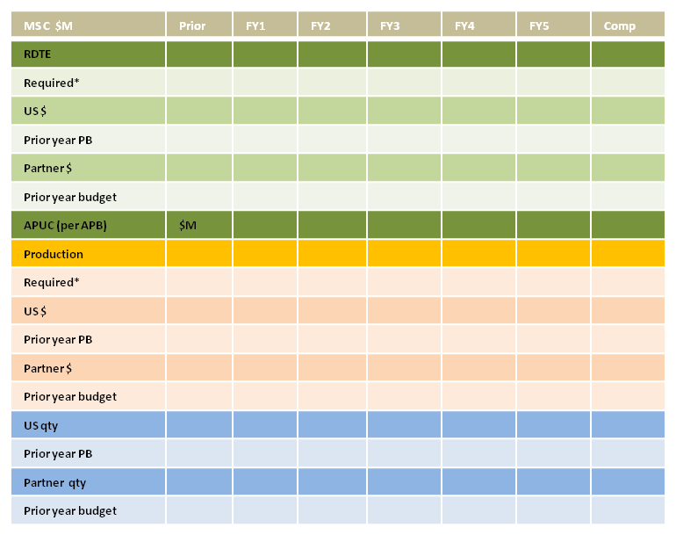
Choose appropriate funding chart below
*-from Spruill chart
Cooperative Activities: (list cooperative partners, describe cooperative participation in the program, both current and planned, to include list of actual international agreements-- e.g., bilateral or multilateral discussions, loans of equipment, information exchanges, cooperative RDT&E, co-production DEA/IEAs in technology area, etc.)
Foreign sales: (list current or potential FMS or Direct Commercial Sales buyers)
Interoperability Requirements: (list all international objective and threshold requirements in program documents (JCIDS and 5000 series); describe plan to achieve those requirements, to include which increment of a program they will be achieved)
Foreign technology assessment: (from TDS and AoA; guidance in Deskbook Acquisition Guidebook, Section 2.3.6., identify how 10USC2350a statutory requirement has been met; assessment whether or not a project similar capability is in development or production in a partner nation that could be procured or modified to meet DoD needs)
Key Technologies: (description of the technologies and CPI in the program)
Anti-Tamper Analysis: (based on ATEA Guidance and Defense Exportability assessment)
Differential Capability Analysis: (Assess potential need for development of differential capabilities for a range of anticipated coalition partners in view of the interoperability requirements, cooperative activities, and potential foreign sales efforts envisioned)
Proposed Approach: (Describe how design and development of validated AT and Differential Capability requirements will be addressed in the program’s master schedule )
(Identify issues specific to international -- e.g., impact (cost, schedule, performance) of proposed cuts on partner(s)/buyer(s), updated APUC, status of negotiations and impact to US and partners under the relevant agreement(s) (MOU, MOA, LOA)

Slide 32
Additional Items to Consider
BBP 3.0 requirement at milestones:
  Effective immediately, ASD(A), ASD(R&E), OIPT leaders, and DASD(SE) will include consideration of technology refresh plans in milestone and decision point reviews
MOSA (Modular Open Systems Approach)

Slide 33
Milestone A – Required Documents
PMs will address their streamlining documentation strategy
Document | Originator | AF OPR | OSD OPR | Approver
2366a Certification | ARA | AQ | ARA | MDA
ADM | OIPT lead/ARA | AQ | ARA | MDA
Acquisition Strategy | AF | AECO | ARA | MDA
Affordability Analysis | AF | AQ | ARA | MDA
Analysis of Alternatives | AF | A5R | CAPE | CAPE & MDA
Capability Development Document (CDD) (draft) | AF | A5R | JROC | JROC
Clinger Cohen Act (CCA) Compliance | AF | A6P | CIO | CIO
Concept of Operations/Operational Mode Summary/Mission Profile (CONOPS/OMS/MP) | AF | A5R | N/A | Component
Cost Analysis Requirements Description (CARD) | AF | AFCAA | CAPE | CAPE
Component Cost Estimate | AF | AFCAA | CAPE | AF
Component Cost Position | AF | FMC | CAPE | FM
Economic Analysis (MAIS) | AF | A6P | DOD CIO | AF
Exit Criteria | AF |  | ARA | MDA
Frequency Allocation Application (DD form 1494) | AF | A6P | DOD CIO | NT &IA

Slide 34
Milestone A – Required Documents
Document | Originator | AF OPR | OSD OPR | Approver
Full Funding Certification Memo | AF | AQX/FMC | ARA/CAPE/AF | MDA/CAPE
Independent Cost Estimate | CAPE | AFCAA | CAPE | CAPE
Life Cycle Mission Data Plan | AF | AF/A2 | DIA | MDA
Life Cycle Sustainment Plan Core Logistics Determination | AF | AQD | L&MR | L&MR
Program Certification to DBS Mgt Committee | AF | SAF/US (M) X |  | DBSMC Chair
Program Protection Planning Cybersecurity Strategy | AF AF | AQL | DASD (SE) | MDA DOD CIO
Replaced System Sustainment Plan | AF | AQD | L&MR/MR | AF
Request for Proposal | AF | AQC | DPAP | MDA release authority
Spectrum Supportability Risk Assessment | AF | A6P | CIO | AF CIO
System Threat Assessment Report (STAR) | AF |  |  | DIA or AF (ACAT IC and IAC)
Systems Engineering Plan IUID Implementation Plan | AF | AQR AQC | SE DPAP | DASD (SE) or SAE if delegated
Technology Targeting Risk Assessment | AF |  |  | DIA validate ACAT ID/IAM
Test and Evaluation Master Plan (TEMP) | AF | AF/TE | DT&E and DOT&E | DT&E and DOT&E

Slide 35
Cost Driver/
Operational Requirements Trade space
See notes
Requirement Cost Driver (i.e. KPP, KSA, other attributes) | Proposed Relaxed Requirements | Operational Risk/Impact | Reduced System Capability | Change in Cost (e.g. LCCE, APUC, RDT&E, Production, O&S, etc.)
KPP 1 : Radar System Performance | Increase search update interval by 5 seconds | Reduces TBM growth capability | Req’d power aperture decreased by 15% | $50M reduction in RDT&E
KPP 2: Sustainment Material Availability | Relax from 64% to 50% | Possibly unable to meet optimum 36mo. maintenance cycles so as to maintain Mission Readiness | Req 2 new aircraft instead of 3 | $9B reduction in LCCE
KPP 3: Mission Execution (Comm) | Partially enable wireless communication | Unable to provide full C3 capability – reduce responsiveness | Integrate with only basic wireless capability | $10M reduction in RDT&E
Notes:
This chart is intended to help the program generate ideas for potential tradeoffs. Data may or may not be available depending on the timing of the Milestone. The table includes operational requirements that are potential tradeoffs and the associated operational and cost impact of the trade. The table includes the KPPs, KSAs, and APAs that are the primary cost and schedule drivers.

