Slide 1
Milestone C Template
Program Title
Air Force Review Board (AFRB) Date
This template is for guidance only
and is not mandatory.
Examples are for illustrative purposed only
Rank, Name
Office Symbol
Date
See Notes Page
FOR OFFICIAL USE ONLY – PRE-DECISIONAL
Notes:
To schedule a HQS AFRB please contact the AFRB Secretariat (SAF/AQXE: Mr Stan Armstead at 571-256-1804 or Major Bryan Lowe at 571-256-0407. The earlier you request a meeting the more likely you will get the dates you need.
AS A REMINDER CHARTS DUE TO THE SECRETARIAT 7 DAYS AHEAD OF THE BRIEFING OR THE MEETING MAY BE CANCELLED.
The purpose behind this template is to provide guidance on the issues and requirements to address at MS C. Each briefing will be different depending upon the nature of the program. Only brief those items that are important for the MDA to make a decision. All briefings should have less than 40 charts (not counting back-ups) to be briefed to SAF/AQ within the one hour and one-half hour that will be scheduled for the meeting.
If you have questions in preparing your briefing please contact your local Acquisition Center of Excellence (ACE) for guidance.
Wright Patterson AFB DSN: 785-5494/COMM: 937-255-5494
Hanscom AFB DSN: 845-1660/COMM: 781-225-1660
Eglin AFB DSN: 875-0526/COMM: 850-883-0526
Warner Robbins DSN 468-0274/COMM: 478-926-0274
Hill AFB DSN: 777-7999/COMM: 801-777-7999 or-777-5538
Tinker AFB DSN: 884-2791/COMM: 405-734-2791
Los Angeles AFB (SMC/PID) DSN: 633-1534/COMM. 310 653-1534
SAF/AQXE Commercial: 571-256-0352 (If you have recommendations to improve the ASP template)
Pls mark documents as follows for ACAT I programs going to OSD per OSD/GC recommendations "CLASSIFICATION/FOR OFFICIAL USE ONLY/Pre-Decisional/DAB Support."

Slide 2
Briefing Outline – Key Items
Bottom Line Up Front (BLUF)
Program Description/Overview
CONOPS
Requirements
  APB-KPPs
MS C Affordability
  Portfolio Perspective
  Affordability Template
Product Support Quad Chart
Test and Evaluation
Acquisition Strategy—Framing Assumptions
  Proposed Schedule and Schedule Assessment
  Business Strategy (Include Competitive Strategy)
  Product ion Rate
  Funding
  Program Risk and Risk Mitigation
  Industrial Base & Manufacturing Readiness
Document Status
Exit Criteria
Recommendations for ADM
Way ahead
Back-up
  International Cooperation, Program Office Resources, Technical and Systems Engineering Assessment, Test and Eval, FMS, Other (eg., open actions from prior ADMs, Congressional concerns/funding cuts)
Notes:
This template is designed as a “guide” for the topics typical to be addressed for a MS C decision.
While it is not mandatory, nor possible, in one hour to address all the subjects, it is prudent to be prepared to brief or address all topics.

Slide 3
Bottom Line Up Front
Purpose
  Present Way Ahead for Program
  Discuss oversight and management plan for Program
Decisions you are requesting (examples)
  Approval Milestone C (or FRP or FDD) (if AF is MDA)
  Approval to proceed to OIPT and DAB (if OSD is MDA)
  Approve Applicable delegations/waivers
List Outstanding Issues
  Issue 1--Integrated Test events
    4 flight tests remaining
  Issue 2—Production funding
    Need FYxx Budget to begin LRIP – GAO report pending
  .
Notes:
FRP= Full Rate Production
FDD=Full Deployment Decision

Slide 4
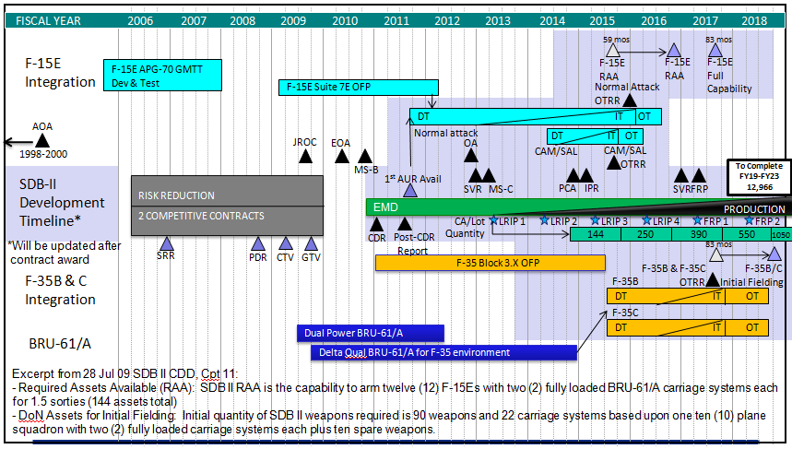
Program Description/Overview
Description
Schedule
Required Funding
Acquisition Strategy
 | Air Force TY$M
 | CFY | FY+1 | FY+2 | FY+3 | FY+4 | FY+5 | Total
AF RDT&E | 86.4 | 79.2 |  |  |  |  | 165.6
FYxx PB RDTE | 126.5 | 153.5 | 162.4 |  |  |  | 731.0
AF Proc |  | 46.9 | 84.4 | 125.7 | 125.7 | 125.7 | 508.4
FYxx PB Proc |  | 46.9 | 84.4 | 125.7 | 120.0 | 120.0 | 497.0
DoN TY$M
DoN RDT&E | 16.5 | 32.2 | 48.1 | 46.5 | 46.5 |  | 189.8
FYxx PB RDTE | 43.7 | 44.2 | 74.9 | 37.6 | 37.6 |  | 238.0
DoN Proc |  |  |  |  |  | 10.3 | 10.3
FYxx PB Proc |  |  |  |  |  | 16.3 | 16.3
  Evolutionary Acquisition
  Sole Source Production contract for LRIP
    Raytheon Missile Systems, Tucson
    The Boeing Company, St Louis
  LRIP-Fixed-Price Incentive Firm Target (FPI(F))
  Production
      Lots 1-3 -- FPI(F)
      Lots 4-5 – Fixed-Price NTE w/ Economic Price Adjust

Slide 5
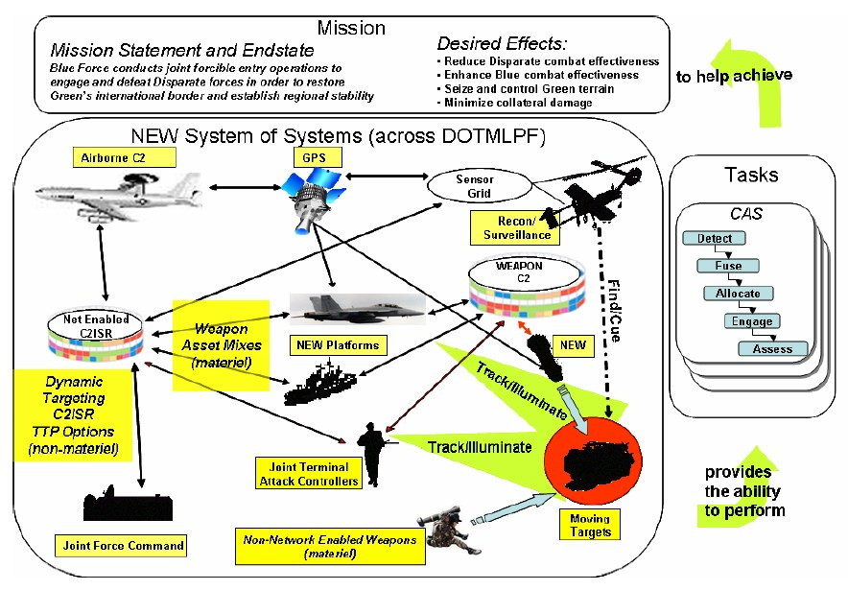
Concept of Operations
Notes:
Threats: Has the threat changed? How does this impact the program? What, if any, changes are necessary for future modifications?

Slide 6
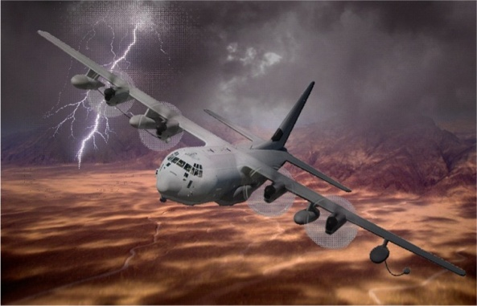
Interrelationships, Dependencies & Synchronization with Complementary Systems
Aviation Platforms:
KC-135
KC-10
AWACS
H/MH-60
CV-22
MH-47
MH-6
CH-53
A/OA-10
HC/MC-130 Recap
Mission Planning
PFPS
JMPS
Ground Teams:
GAWS
SF
SEAL
STS
Be sure to include CYBER links and infrastructure. Indicate any issues/cybersecurity risks introduced by program interconnection.
C-130J:
Aircraft Procurement
& Block Upgrades
LAIRCM
Solid denotes current system
Dash denotes future system
Arrow to Recap denotes supports Recap
Arrow from Recap denotes Recap supports
Indicates program are interdependent
No known issues affecting inter-related programs
Resolvable interface issues affecting programs
Unresolvable interface issues affecting programs
Notes:
Purpose:
Very few programs today operate or function independently. Most programs are affected by other components and systems, and it usually takes a combination of programs to accomplish the full effects of a weapon or communication system. The Program Manager of the reviewed program is the best source of information on which programs/systems the reviewed program depends upon either operationally (supports other weapon systems), physically (embedded components) or systemically (communications or digital links).
Business Rules:
a. Programs to Include:
The reviewed program is in the center of the chart with any crucial interrelated programs, including communication links and cyber infrastructure, listed with arrowheads denoting the direction of dependency. Crucial interdependencies are such that the program under review cannot achieve capabilities articulated in the CONOPs, CDD, or CPD (as appropriate) without the related capability provided by this program. Two way dependencies will have a double-headed arrow. Program groupings, where possible, should be by mission or capability area vice platform type. Include programs currently in development.
b. Availability:
Indicate whether the deliverables from one program to the other are on track, both in quantity and in schedule. If either of the interrelated programs are at risk of missing giver-receiver dates, color the interdependency arrow red or yellow for the appropriate severity. Be prepared to discuss reason for delay, impact, and mitigation.
c. Interoperability:
Indicate whether the technical performance requirements are being met by the interrelated programs such that they will be able to integrate and function together. Assess both hardware and software/data interoperability. If there is a risk or issue affecting the interoperability of the systems, color the interdependency line red or yellow for the appropriate severity. Be prepared to discuss interoperability issues, impact, and mitigation.
d. Security:
While systems may be available and interoperable, there may exist security risks to the Reviewed program or due to the interconnection with the crucial interrelated programs identified. Consider all areas of security that result in overall mission risk, including: Personnel Security, Physical Security, Software Assurance, Cybersecurity, Supply Chain Risk Management, Anti-Tamper, Industrial Security, Operations Security, and Communications Security. Color the interdependency line green, yellow or red for the appropriate risk level. Be prepared to discuss moderate/high risks, impact, and mitigation.

Slide 7
Requirements
Operational Requirements
  When Approved (AOA, ICD/CDD/CPD, CONOPS)
  Key KPPs—fully identified and clearly stated?
  Incremental Requirements?
  How does the program baseline compare to validate requirements
Operational Capabilities/Impacts
  Capabilities / missions (today & future)
    Relationship to established roadmap(s) / architecture(s)
    Family of Systems (FOS) / System of Systems (SOS) / Complementary Systems
      Example for E-10A: MP-RTIP, Global Hawk, MP-CDL, Army CGS
AFSPC/AFMC/CC Attestation Statement (See notes)
(See Notes for SSRA/ESC)
Notes:
MAJCOM/CC Attestation Statement (Provided by AFMC/A5C or AFSPC/A5C). See AFI 63-101: Both AFSPC and AFMC will attest that the capability requirements as described in all CPDs…are feasible. If appropriate, attestation will be completed concurrent with document presentation to the AFROC.
DoDI 4650.01 page 12 covers Spectrum Supportability Risk Assessment, Consider Spectrum Supportability Risk Assessment Status and Equipment Spectrum Certification Stage impact on requirements.

Slide 8
APB Key Performance Parameters
Why they matter. . .
Notes:
8
What matters:
Top KPP/KSAs that are the primary drivers of cost, schedule, and risk for this program
Requirements that are the most significant drivers of technical and schedule risk

Slide 9
Affordability
MS C Affordability Goal: ?
MS C APB APUC Objective: ?; APB Threshold: ?
  Estimated APUC at ?
Two Affordability changes are drafted in the (Specify Milestone) ADM
  Reflect the APUC Affordability Goal at ?% above APUC objective ($?)
Are there Cost Affordability Drivers?
  If so, please explain.
Are there any disconnects throughout the lifecycle?
  How will the disconnects be addressed?
Are there any Schedule drivers impacting the Affordability Goal?
  If so, please explain.

Slide 10
Affordability Requirement
Description | Affordability Requirement (MS ? ADM) BY?? | Dec 17 SAR (In DAMIR) BY??: $? | Service Cost Position Estimate (23 Oct 18) BY??: $??
APUC (Note 1) | $? | $? | $?
O&M | $?/Unit | $?/Unit | $?/Unit
Note 1:
Quantity
APB APUC Objective $?
APB APUC Threshold $?
Notes:
Affordability Template MS C (Single Quad Chart)
Purpose: Provide the Affordability Requirements and amplify information on RDT&E and Procurement learned during design trades.
Top left quadrant: Display proposed Affordability Requirements for MDA approval. In most cases these will be the same areas used as Affordability Targets from MS A, updated to reflect the results of affordability decisions made since that time. These will be precise expressions of cost and schedule to be controlled and should have been weighed objectively for both front-end unit cost and long-term ownership cost, and be based on engineering analysis. The PM should be prepared to explain why any elements from MS A/B were not selected for MS C, or any new elements added for MS C.
Top right quadrant: Provide results of the most significant trade studies addressing Affordability Drivers. First row should be the baseline estimate of each cost element from MS A, subsequent rows should show “delta” effects of each trade study on the cost elements. The bottom row should show a current estimate, which should include but not be limited to, the info in the table. (Because not all trades can be shown in the table, the columns may not add correctly. However, if the chart shows the most significant results they should not be excessively out of line.) The current estimate should be consistent with budget information shown elsewhere in the briefing deck.
Bottom:
Discussion points.
Consider Spectrum Supportability Risk Assessment Status and Equipment Spectrum Certification Stage impact on cost due to the long lead times.

Slide 11
Program Requirements
Top Requirements Cost Drivers
Performance (KPPs & select KSAs)
KPP 1
Extended Range
KPP 2
MME
KPP 3
Mat. Availability*
KPP 4
Net Ready
KSA 1
Reliability
MS B Date: N/A
MS C Date: Oct 10
* Analysis
N – No Capability
T – Threshold
O - Objective
N
T
O
Technology Readiness Assessment
Acquisition Program Baseline (APB)*
Critical Technologies | To Date | Est. @ FRP
Engine | 8 | 9
Engine Lube System | 8 | 9
FMU 156/B Fuze | 9 | 9
Low Observable | 7 | 7*
GPS | 7 | 7*
Baseline (O)
+10%
+15%
Cost
PAUC
G
$1.1M
$1.21M
$1.265M
Cost
Baseline (O)
+10%
+15%
APUC
G
$1.1M
$1.21M
$1.265M
Schedule
- MS C
- Assets Avail.
(O) Sep 10
(T) Dec 11
G
(O) Apr 13
(T) Apr 14
* Based on proposed APB
TRLs meet LRIP entrance criteria
* Due to testing constraints
G
Notes:
Top Cost Driver:
Identify the top 5 or so areas that drive current program costs and their percentage of total program Acquisition Costs.
The 5 or so areas combined should represent at least 75% total program costs.
Performance (KPPs & select KSAs)
The actual Objective and Threshold values from the APB will be added in place of the “T” and “O”.
The arrow locations and color are based on the PMs current estimate.
Placement of the arrow reflects current status of the TRL that best supports obtaining the Threshold/Objective value of the KPP/KSA (i.e., a KPP/KSA with supporting TRL of 6 or below will be positioned to the left of the Threshold value, and will vary depending on how close the TRL is to achieving 7 or better.
Use Red to indicate that the KPP Threshold value cannot be achieved without reaching or exceeding 10% of the APB Cost Baseline or exceeding 6 months from the APB Schedule Baseline.
Use Yellow to indicate that there is risk of not meeting the KPP threshold & identify, on a separate chart, the corrective actions taken.
Use Green to indicate that KPP Threshold has been achieved or is on a path to be met within current APB Cost and Schedule baselines.
The intent is not to list every KPP or attribute. However, should include, at a minimum the KPPs and KSAs associated with cost, schedule or technology challenges. Add the KPP/KSA title under the KPP/KSA number listed
Technology Readiness Assessment
Identify the critical technologies for the program.
Provide the SPO estimated TRL assessment for the Next Major Milestone (consistent with the MS chosen for the APB Schedule section).
Acquisition Program Baseline
Input the Objective Cost or Schedule from the APB in place of “Baseline”. If there is no APB, so state; however, provide program office estimated baseline information.
The arrow location and color are based on the PMs current estimate.
Use Red to indicate that the Cost/Schedule values will reach/exceed 10% of APB Cost Baseline or 6 months from APB Schedule Baseline.
Use Yellow to indicate that there is risk of reaching or exceeding 10% of the APB Cost Baseline or 6 months from the APB Schedule Baseline and identify, on a separate chart, the corrective actions taken to correct.
Use Green to indicate that Program capabilities will be delivered within the APB Baseline Cost and Schedule.
Identify the APB’s Objective Cost, Program Acquisition Unit Cost (PAUC) & Average Procurement Unit Cost (APUC) for the program.
Identify either the Objective IOC or FOC values which ever is next.
Identify the + 10% and + 15% values from the APB Cost Baseline Values.
Identify the +6 months and +9 months values from the APB Schedule Baseline Values.
The next major program event will be identified (MS A/B/C, PDR, CDR, DT/OT, OPEVAL, FIRST FLIGHT, ETC)
Provide MS B and C Dates in box indicated.
Attestation Statement
This chart along with the PM of Record signed Requirements Feasibility Assessment Memo provides information necessary for AFMC/CC’s Attestation stated on the Requirements Chart in this briefing.

Slide 12
MS C
Cost Capability Analysis
Have there been any updates to the cost estimate or KPPs? If so, what trades were made to arrive at those values and what are the cost, schedule, technical, operational implications?
Are there any updates to your Acquisition Strategy and business approach for Production? Describe the decision process used to arrive at this approach, including any trade studies conducted.
What are the program risks? Describe what specific production design and other risk mitigation activities have or will be conducted to reduce the risk to acceptable levels, what technology or other trades were conducted to determine

Slide 13
Product Support
Product Support Strategy
Metrics Data
Sustainment Approach
  Current (initial CLS covering total system)
  Future (sub-system based PBL contracts)
Issues
  Shortfall in O&M funding in FYDP
  Reliability and availability estimates are below goals
  LCSP requires update before DAB
Resolution
  POM request for O&M restoration submitted
  Reliability improvement plan with clear RAM goals up for final signature
  LCSP in draft
Metric | Antecedent Actual | Original Goal | Current Goal | Current Estimate/ Actual
Materiel Availability | 76% | 80% | 77% | 71%
Materiel Reliability | 37 hrs | 50 hrs | 50.5 hrs | 48 hrs
Ownership Cost | 245.6B | 385.5B | 395.1B | 395.1B
Mean Down Time | 12 hrs | 20 hrs | 18 hrs | 15 hrs
* Test or fielding event data derived from _______
Today
Sustainment Schedule
O&S Data
Cost based on average annual cost per squadron
MS B
MS C
IOC
FRP
FOC
Sustainment
Cost Element | Antecedent Cost | ABC Original Baseline | ABC Current Cost
1.0 Unit-Level Manpower | 3.952 | 5.144 | 5.750
2.0 Unit Operations | 6.052 | 6.851 | 6.852
3.0 Maintenance | 0.739 | 0.605 | 0.688
4.0 Sustaining Support | 2.298 | 2.401 | 2.401
5.0 Continuing System Improvements | 0.129 | 0.025 | 0.035
6.0 Indirect Support | 1.846 | 1.925 | 1.956
Total | 15.046 | 16.951 | 17.682
BCA
BCA
BCA
BCA
LCSP
PBL Recompete
LRIP Contract Award
Avionics PBL
CLS Start
PBL Recompete
Depot Standup
Blended Partnership Startup
Total O&S Costs | Antecedent | ABC
Base Year $M | 102,995.2 | 184,011.9
Then Year $M | 245,665.3 | 395,147.2

Slide 14
Program Schedule
FISCAL YEAR
2012
2013
2014
2015
2016
2017
2018
2019
2020
2021
2022
2023
2024
NEED TO ADD TOP LEVEL CRITICAL PATH
59 mos
83 mos
F-15E
Integration
F-15E APG-70 GMTT
Dev & Test
F-15E
RAA
F-15E
RAA
F-15E
Full
Capability
F-15E Suite 7E OFP
Normal Attack
OTRR
Note: Due to delay of MS B, shaded blue region will move right accordingly
DT IT OT
AOA
Normal attack
DT IT OT
1998-2000
JROC
EOA
OA
CAM/SAL
CAM/SAL
OTRR
SDB-II
Development
Timeline*
MS-B
1st AUR Avail
To Complete
FY19-FY23
12,966
RISK REDUCTION
2 COMPETITIVE CONTRACTS
SVR
MS-C
PCA
IPR
SVR
FRP
EMD
CA/Lot
LRIP 1
LRIP 2
LRIP 3
LRIP 4
PRODUCTION
Quantity
FRP 1
FRP 2
*Will be updated after
contract award
CDR
Post-CDR
Report
144
250
390
550
1050
SRR
PDR
CTV
GTV
83 mos
F-35 Block 3.X OFP
F-35B & F-35C
OTRR
F-35B/C
Initial Fielding
F-35B & C
Integration
F-35B
DT IT OT
F-35C
BRU-61/A
Dual Power BRU-61/A
DT IT OT
Delta Qual BRU-61/A for F-35 environment
Excerpt from 28 Jul 09 SDB II CDD, Cpt 11:
Required Assets Available (RAA): SDB II RAA is the capability to arm twelve (12) F-15Es with two (2) fully loaded BRU-61/A carriage systems each for 1.5 sorties (144 assets total)
DoN Assets for Initial Fielding: Initial quantity of SDB II weapons required is 90 weapons and 22 carriage systems based upon one ten (10) plane squadron with two (2) fully loaded carriage systems each plus ten spare weapons.
13
Notes:
Identify Major Schedule Drivers:
Obsolescence?
Are we trying to beat someone in this competitive space, and what’s the value proposition for doing so?
What technical issues pace the project?
Note: Program schedule shall address critical path

Slide 15
Program Schedule
FY13 FY14 FY15 FY16 FY17 FY18 FY19 FY20 FY21 FY22 FY23 FY24 FY25
MDD
IOC
FDDR
Milestones
AFRB
FOC
RIT
ICD
Requirements Review/Management Board
Requirements
Annual
X-Plan
Design & Integration
System/Architecture Studies
Highlight critical path.
Acquisition
Test & Evaluation
OUE
OT&E
Contracting
CA
Operations & Support
  Strategic & focused on Milestones and critical events between milestones. Must communicate schedule changes
Notes:
Ensure that the critical path is highlighted
Identify critical events between milestones
Identify ADM requirements as necessary
Tailor schedule as necessary to identify cost, and/or schedule issues
Tailor schedule as necessary to reveal phases and/or increments of efforts
If event driven CSB, show integrated master schedule, highlighting issues
For pre-MDAP/MAIS programs, project a planned schedule
Must communicate schedule changes (include original date and the slipped date)
Consider to add Spectrum Supportability Risk Assessment Status and Equipment Spectrum Certification Stage impact on requirements. These have impacts on milestones, requirements and acquisition process.

Slide 16
Test and Evaluation
Describe the Strategy for T&E and how it supports the acquisition, requirements, and cyber security strategies
  Describe any disconnects between these 4 strategies
Any OSD issues with TEMP or IOT&E plan approval?
    Time constraints
    Funding constraints
    Test article and test facility/range constraints
    Qualified T&E personnel shortfalls
Has the system been certified ready for dedicated operational testing?
  Are all Critical Operational Issues (COI), Critical Technical Parameters (CTP), and Measures of Effectiveness (MOE) linked and covered?
  What problems and deficiencies remain unresolved from DT&E?
    Address negative Test results
    Address DT&E issues remaining
Notes:
A major question always in testing that DASD(DT&E) and DOT&E look especially hard at these areas is the sufficiency of funding and number of test articles which are often major shortfalls when TEMPs are reviewed

Slide 17
SAMPLE APT Framing Assumption #1
“PRE-DECISIONAL – NOT FOR RELEASE”
Purpose-built will be competitive with existing designs
Framing Assumption
Basic aircraft and training system designs will be complete through vendor-conducted CDRs
Best-value source selection must consider risk
Implications
Single step to full capability
Expectations
Enter at MS B
Limited EMD of “deltas” to meet spec
PDR and competitive prototype waivers applicable*
Contractor flight data to validate performance
Single award for EMD, Prod and ICS
RAA in 2023
FOC in 2031
*Air Force will still conduct comprehensive PDR and Critical Design Review (CDR) events post-contract award in support of Better Buying Power (BBP) 3.0 “Strengthen organic engineering capabilities” and SAF/AQ’s OTB Initiative.

Slide 18
Sample APT Framing Assumption #2
“PRE-DECISIONAL – NOT FOR RELEASE”
APT
requirements only
Framing Assumption
Mature technologies and systems available
AETC sole customer
Implications
Single step, limited EMD, waivers etc.
Separate PPBE
process for
other T-38 owners
Separate Planning Programming Budgeting and Execution (PPBE) process for APT derivative use capabilities
Expectations
IOC 2023

Slide 19
Alt Sample Framing Assumptions
Assumption* | Implications** | Expectations*** | Metric****
Design is Mature | Production concurrency possible | Schedule to IOC will be achieved | Schedule growth below historical median
Threat levels will not change much in the next 5 years | Capability changes unlikely | Costs to
Commercial demand will reduce unit cost | Production cost Est is realistic | No additional funding needed nor cost growth
See Notes pages for information
Notes:
*The PM and team should develop the programs Framing Assumption and track the validity of the FAs by assessing relevant program metrics.
**Show implications, expectations and metrics for each key framing assumption. Thee should only be a few FAs (3-5); each should have these properties, cause major consequences, have no simple work-around, be uncertain at this point, be program specific (not generic, lie funding stability or good contractor performance ) and be a fundamental assumption that affect management decisions.
***Describe the visible expectations that flow from each implication of the FA.
****Specify metrics that can show whether these expectations are seen

Slide 20
Program Org Chart
OSD/AT&L
User
SAF/AQ
Depot
ACC/A5XX
Col B Martin
PEO
Lt Gen JP Jones
OO-ALC/XYZ
Col Al Griggs
PM
Col John Smith
Program
Control
Maj D. MacArthur
Contracts
Ms. Jane Smith
Sys Eng
Maj Kelly Johnson
PSM
Lt. Col T. Jones
Test
Maj C. Yeager
PC IPT
2 Captains
1 GS-12
5 Contractors
Contracts IPT
2 Captains
1 GS-12
Sys Eng IPT
2 Captains
1 GS-12
5 Contractors
Support IPT
1 Captain
1 GS-12
4 Contractors
Test IPT
2 Captains
1 GS-12
5 Contractors
Notes:
Use existing program org charts so long as they show from MDA through PM and major IPTs within the program office.
In no case shall there be more than two levels of review between the Program Manager and the Milestone Decision Authority in accordance with DODD 5000.01, DODI 5000.02, and AFPD 63/20-1.
Include in your chart the Program Control Office, if you have one.

Slide 21
Business Strategy
Competition Strategy
  How will competition be established and maintained through all phases of the acquisition (to include spares and depot repair) ?
  How does the competition strategy facilitate the acquisition strategy?
  What is the competition strategy for the upcoming acquisition phase?
  How do the results of the last acquisition phase impact the strategy for the upcoming phase?
  MOSA
For Each Contract
  What is the purpose, type and value of the contract?
  How is the contract aligned with the acquisition/competition strategies?
  What is the incentive structure and how will the incentives foster contractor behavior resulting in favorable cost, schedule and performance outcomes?
  What criteria will be used to select the winning bidder? How do those criteria emphasize what is most important to the government?
  Will warranties be employed? How will they benefit the government?
  Does the contract anticipate the acquisition of technical data?
  Are you able to buy in economic ordering quantities?
  MOSA Integration

Slide 22
DoD 5000.02 Tailoring Strategy
Discuss overall 5000.02 tailoring strategy
  Is program requesting approval for specific tailoring at this meeting?
  If not, why?
Discuss areas that have been tailored previously
Recommend area(s) that program intends to target for tailoring in future
Identify necessary dates & timelines to return for tailoring approval

Slide 23
Program Funding
Notes:
Notes:
+Enter values in the unshaded (white) annual and to-complete cells only. The rest of the data is calculated automatically. The spreadsheet cells will round to the nearest hundred thousand dollars ($0.1M).
+Delete any appropriation sections that have no budgeted or required costs.
+Programs must use footnotes to state source of "Required" estimate, O&S service life projection, O&S time horizon (first year of O&S – last year of O&S) & cost categories, and any RDT&E-funded quantities (if any). See Figure 1.
+Program offices are to use the latest version of the program funding template. Regularly check the Acquisition, Technology and Logistics (AT&L) Defense Acquisition Board (DAB) online calendar website (https://ebiz.acq.osd.mil/DABCalendar/) for the most current Integrated Product Team (IPT) Program Funding template. The template is updated as Programming, Planning, Budgeting, and Execution System (PPBES) events occur.
Definitions:
Primary Line Items: In the header of each section, list the primary budget line item(s) that fund the program currently and in the FYDP. For RDT&E, MILCON, and O&M, include appropriation (consistent with DAMIR reporting), budget activity and program element. For procurement, include appropriation, budget activity and line item. Some programs have smaller amounts of funding in secondary line items that need not be listed. Footnotes may be used for clarification/amplification.
Prior: President’s Budget (PB) position submitted prior to the Current budget position. Although the President only submits the FYDP to Congress, the cells for the next fiscal year and “To-Complete” should be populated for the investment appropriations using the values reported in the Selected Acquisition Report or latest DAES associated with that PB (if available).
Current: Latest approved Service POM/BES budget position or approved PB.
+During a normal PPBES cycle (PB submitted in the first Tuesday of February each year), use POM position from August through January; Use PB position from February through July.
+When the DoD Appropriation is enacted, programs should update that cell of all the "Current” PB funding and quantity rows to reflect the actual appropriated amounts.
Required: Latest estimate of funds required to successfully execute program, i.e., support the Warfighter and not simply match available budget Total Obligation Authorities (TOAs). Typically, this would reflect the Will Cost estimate, Service Cost Position (SCP), or PEO-supported Program Office Estimate (POE) that has not yet been validated by a Service Cost Agency or the CAPE. Note: total required quantity is the acquisition objective recognized by the Joint Requirements Oversight Council (JROC) or similar body and would be reflected in the program's Acquisition Program Baseline (APB) or similar document but may not be reflected in the budget due to affordability or funding issues.
System O&M: In this section, list the O&M-funded costs from initial system deployment through end of system operations. Include all costs of operating, maintaining, and supporting a fielded system. Specifically, this consists of the costs (organic and contractor) of equipment, supplies, software, and services associated with operating, modifying, maintaining, supplying, training, and supporting a system in the DoD inventory. Do not include acquisition-related O&M, and non-O&M O&S costs such as military personnel, and investment-funded system improvements. Also, do not include disposal costs, which represent a separate phase of the program life cycle. Please address questions on the O&M requirements to the OSD(AT&L)/L&MR point of contact listed below.
Total Required Acquisition (BYXX$M):
+Current Estimate of Total RDT&E, procurement, MILCON and acquisition-related O&M in base-year dollars as reported in the program's latest approved POM budget position, approved PB, or quarterly DAES submission, whichever is most current.
+The percentage displayed is the portion of the Acquisition cost out of the sum of Acquisition and O&S costs.
+Revise “BYXX$M” to reflect the 2-digit program Base Year (e.g., BY16$M). Use the Base Year specified in the current Acquisition Program Baseline (APB). For unbaselined programs (or if seeking a new or revised APB), use the budget year (e.g., BY18$M for PB18).
Total Required O&S (BYXX$M):
+Current Estimate of Total Operating and Support costs in base-year dollars as reported in the program’s quarterly DAES (if applicable). See Figure 2.
+A footnote should identify the projected service life.
+Disposal costs should not be included in this value.
+The percentage displayed is the portion of the O&S cost out of the sum of Acquisition and O&S costs. This value should not include disposal dollars.
+Revise “BYXX$M” to reflect the 2-digit program Base Year (e.g., BY16$M, IAW the instructions above for Total Required Acquisition).
Curr Est (APUC): Program Manager’s current estimate of Average Procurement Unit Cost, in base-year dollars (total procurement divided by procurement-funded quantities). The APUC should match the values reported in the program's latest approved POM/BES budget position, approved PB, or quarterly DAES submission, whichever is most current.
Curr Est (PAUC): Program Manager’s current estimate of Program Acquisition Unit Cost, in base-year dollars (total RDT&E, procurement, MILCON and acquisition-related O&M divided by total quantity). The PAUC should match the values reported in the program's latest approved POM/BES budget position, approved PB, or quarterly DAES submission, whichever is most current.
Δ Current: This is the program’s APUC or PAUC current estimate (as defined above) divided by the program’s current APB Unit Cost Reporting (UCR) baseline, as applicable. Figure 3 illustrates where this information resides in the program’s DAMIR DAES.
Δ Original: This is the program’s APUC or PAUC current estimate (as defined above) divided by the program’s original APB UCR baseline, as applicable. See Figure 3.
Points of Contact:
Army Programs:
Allen Johnson, OSD(AT&L)/ARA
allen.m.johnson44.ctr@mail.mil
703-697-5384
Navy Programs:
CDR Joseph Mitzen, OSD(AT&L)/ARA
joseph.b.mitzen.mil@mail.mil
703-697-8020
Air Force Programs:
Matthias Maier, OSD(AT&L)/ARA
matthias.r.maier.ctr@mail.mil
703-614-4030
Agency & Department-wide Programs:
Mr. Russ Vogel, OSD(AT&L)/ARA
russell.a.vogel.civ@mail.mil
703-697-1786
O&S Section:
Ms. Molly Mertz, OSD(AT&L)/L&MR
mary.m.mertz.civ@mail.mil
703-614-6137

Slide 24
Program Risks
Insufficient funding to execute aircraft quantity requirements
Driver: Two Forward Price Rate Agreement (FPRA) increases, Apr FPRA and Nov FPR Recommendation (driven by a reduction in the base vs. predictions, erosion in the commercial business, efficiencies in production, a recent strike, and pension liabilities) and potential additional rate impacts due to Pension Protection Act compliance and projected business base loss in FY14 due to decreasing procurement of V-22s are creating additional budget pressure to execute yearly budgeted a/c quantities and pressurizing APB and Nunn-McCurdy acquisition thresholds.
Mitigation Plan:
Finalize technical evaluation and negotiation of the lot 7 contract {Leadership intervention as required}
Assess potential future rate increases and impacts on budget across program fiscal years (ongoing)
  Pension Protection Act assessment (AIR 4.2 Lead)
  Business base (DCMA lead)
Continue to Pursue cost reduction/control initiatives (ongoing; see affordability risk)
Update program manager’s cost estimate
Engage Service for funding resolution
Support PEO(A)/DCMA rate control initiative with Bell (ongoing)
Date: Oct 10 (AH-1Z FRP decision)
Failure to Meet Total Ownership Cost Reduction Goals
Driver: Delayed I and D level standup, dynamic component DL&T disposition, extended ICS, components not making reliability targets
Mitigation Plan:
Conduct BCA for long term logistics sustainment/PBL strategy
Stand up Organic Intermediate and Depot Level repair
NAVAIR approval of H-1 DL&T’s
Execute 5 year Interim Support Plan contract awards
CILR drives component redesign efforts/BCAs
Date: Ongoing
Consequence
Likelihood
Bell Supply Chain Management to Support Increase to Full Rate Production
Driver: Poor performance of key suppliers, long lead times (bearings, forgings, castings), LLT purchase orders, staffing, parts shortages, and limited capacity in critical suppliers
Mitigation Plan:
Obtain Advanced Procurement in FY10
Hire Govt Supply Chain Manager (V-22)
Identify dual source for critical suppliers
Rationalize supply base
Place Bell reps on-site at critical suppliers
Hire staffing to meet demand
Utilize Bell gated process for outsourcing
Award FY10 Long Lead
Support Prime key supplier visits with government representation
Production Readiness Review (support FRP decision)
Date: COMPLETE Jul 10 (Risk will be closed/deleted next quarter)
Ability to Achieve Affordability Targets to Meet Inventory Objectives
Driver: Higher than anticipated costs due to Bell enterprise growth (overhead rates); raw materials; cabin; supplier performance; increased labor hours. Two rate increases, Apr Forward Price Rate Agreement and Nov Forward Price Rate Brochure (driven by a reduction in the base vs. predictions, erosion in the commercial business, efficiencies in production, a recent strike, and pension liabilities) have recently created additional budget pressure.
Mitigation Plan:
Establish Affordability plan
Implement GFE CRIs (Engines, OTO)
Obtain Advanced Procurement in FY10
Execute Long Term Agreements/Long Term Contracts
Finalize SOF inspection requirements
Implement cost growth control and cost reduction initiatives
Assess impacts of PB11 Budget and rate increases with Lot 7 Production Proposal
Include spares in production contract
Complete Business Case Analysis for MYP
If supported by BCA, ensure MYP budget approval/lay-in and implement MYP to begin in FY14
Date: On-going
Notes:
24
24
Ensure that you consider intelligence impacts as an area for risk to program.
The DoDI 5000.0-2 requires a demonstration for MS B that all sources of risk have been adequately mitigated to support a commitment to design for production. This includes technology, engineering, integration, manufacturing, sustainment, and cost risks

Slide 25
Industrial Base Assessment
Industry capabilities validated during EMD phase
  Group A and B kits produced for 7 a/c installs
  Production Readiness Reviews complete
Supplier proposals / price quotes submitted for entire bill of materiel
  FPI option negotiated for LRIP & FRP
Diminishing Manufacturing Sources (DMS) / Material Shortages (MS) issues identified and mitigated
  Proactive screening program to identify new issues as they emerge
  In place Life of Type (LOT) purchases provide mitigation
    38 items identified and on-contract

Slide 26
Manufacturing Readiness
MRA Summary
Assessed manufacturing readiness to manage risk while increasing ability to transition technology to weapon systems
  Status of Production Readiness Review (PRR)
MRL 8 - Pilot line demonstrated ready for LRIP
MRA Objectives:
  MRL 8 by Milestone C
  Identify items to watch during LRIP
Bottom line:
  Program X contractor & suppliers have adequately demonstrated manufacturing maturity to proceed into LRIP
  All sub-systems have achieved MRL of 8 or higher
See Footnotes
Notes:
For additional information on MRLs See the Defense Acquisition Guidebook, https://acc.dau.mil/CommunityBrowser.aspx?id=638295 , section 4.3.18.18.3
"Assessing Manufacturing Readiness and Risk,“ which discusses assessment of risk in manufacturing. Within this paragraph if you click on DoDI 5000.02,
Enclosure 2 it will lead you to documents that define the requirement for manufacturing processes and risks. One of the documents it points to is the
MRL Deskbook, version 2.3, May 2015.

Slide 27
MS C Document Status
Documentation | S/R* | Status | Comments
2366b Certification (if program initiation) | S | In OSD Coord
Acquisition Decision Memorandum (ADM) | R | In draft form
Acquisition Program Baseline (APB) | S/R | In-Work | Program Office will finalize after AFCAA
Acquisition Strategy (update) | S/R | Complete
Affordability Analysis (update) | R | In Coord | In SAF 3-ltr Coord
Analysis of Alternatives (AoA) (update) | S | Final
Bandwidth Requirements Review (update) | S | Final | .
Capability Production Document (CPD) | R | Final
Clinger-Cohen Act Compliance | S | In-Work | To be completed prior to MS C DAB
Concept of Operations/ Operational Mode Summary/ Mission Profile | R | Complete
PMs will address their streamlining documentation strategy
Complete | On-Track | Minor Issues | Major Issues
* S=Statutory, R=Regulatory

Slide 28
MS C Document Status
Documentation | S/R* | Status | Comments
Core Logistics Determination/Core Logistics and Sustaining Workload Estimate | S | In-work | AFMC should complete by end of June
Component Cost Estimate | R | In-Work | SCP in work to finalize 30 May. Affordability analysis to finalize after SCP numbers available
Component Cost Position | R | In-work
Cost Analysis Requirements Description (update) | R | Final
Exit Criteria | R | Final
Frequency Allocation Application (DD Form 1494) | S | Final
Full Funding Certification | R | On-track | Awaiting ICE
Independent Cost Estimate | S | In-Work | To be completed NLT 30 June (AFCAA coordinating with CAPE)
Independent Logistics Assessment | S | Finished
PMs will address their streamlining documentation strategy
Complete | On-Track | Minor Issues | Major Issues
* S=Statutory, R=Regulatory

Slide 29
MS C Document Status
Documentation | S/R* | Status | Comments
Information Support Plan Net-Centric Data Strategy | R | Complete
Life Cycle Mission Data (update) | R | In-Work | Update to be complete by 30 June
Life Cycle Support Plan (update) | R | On-track | Awaiting AQD coordination
Manpower Estimate Report (update) | S | Complete
Preservation & Storage of Unique Tooling Plan | S | Complete
Problem Statement (DBS) (Update) | R | Complete
Program Environ.Safety and Occ Health Eval (update) | S | Complete
Program Protection Plan (update) Cybersecurity Strategy | R S | Complete
PMs will address their streamlining documentation strategy
Complete | On-Track | Minor Issues | Major Issues
* S=Statutory, R=Regulatory

Slide 30
MS C Document Status
Documentation | S/R* | Status | Comments
Spectrum Supportability Risk Assessment | R | Complete
Systems Engineering Plan (Update) Item Unique ID implementation Plan Corrosion Prevention Control Plan (Update) Manufacturing Risk and Readiness | R | In-Work | In work to finalize 30 May.
System Threat Assessment Report (Update) | R | Final
Technology Readiness Assessment (as applicable) | S | Finished
Test & Evaluation Master Plan (update) | R | In-work | In final coordination at DOT&E
Waveform Assessment Application (Update) | R | Final | PEO signed 14 May
PMs will address their streamlining documentation strategy
Complete | On-Track | Minor Issues | Major Issues
* S=Statutory, R=Regulatory

Slide 31
Proposed LRIP Exit Criteria
Element | Criteria
Technical Demonstrate system performance, effectiveness, software maturity and interoperability | 100% verification/validation of CPD-defined Key Performance Parameters Receipt of DOT&E beyond LRIP Report Classification of all DRs—no unfixed/unverified CAT 1 DRs Airworthiness approval Completion of Functional Configuration Audit and Physical Configuration Audits
Manufacturing Validate production facilities are ready | Completion of kit proofs Completion of manufacturing risk assessments MRL of 9 or manufacturing maturity plan in place Demonstrate a Full Rate Manufacturing capability
Supportability Demonstrate suitability and long-term sustainment strategy | 100% compliance w/CPD supportability/maintainability threshold requirements 100% organizational technical orders published Delivery of support equipment/spares Delivery of 1 Weapons System Trainer, 1 Avionics Part Task Trainer Demonstrate a Full Rate Manufacturing capability Demonstrate Reliability
Cost Demonstrate production affordability | Updated production-cost estimate, based on LRIP actuals Budget must fully support fully funded estimate

Slide 32
ADM Proposed language
Proposed Acquisition Decision Memorandum language:
I approve MS C and authorize entrance into Low Rate Initial Production phase
Approval of MS C Acquisition Strategy
LRIP quantity up to 250 missiles
Delegation of MDA to AF (ACAT IC or IAC)
I approve the proposed Exit Criteria
  XXX
  YYY
  ZZZ

Slide 33
Way Ahead
Awaiting OSD approval of APB
OIPT scheduled for XX Date
DAB scheduled for XXX Date

Slide 34
BACKUP
See Footnotes for additional information
Notes:
International Cooperation, Systems Assessment and the other topics included in Back-up should be moved forward to the basic briefing when they are a “key part” that needs to be addressed in the Briefing. BUT keep in mind the 1 hour limit to the briefing.

Slide 35
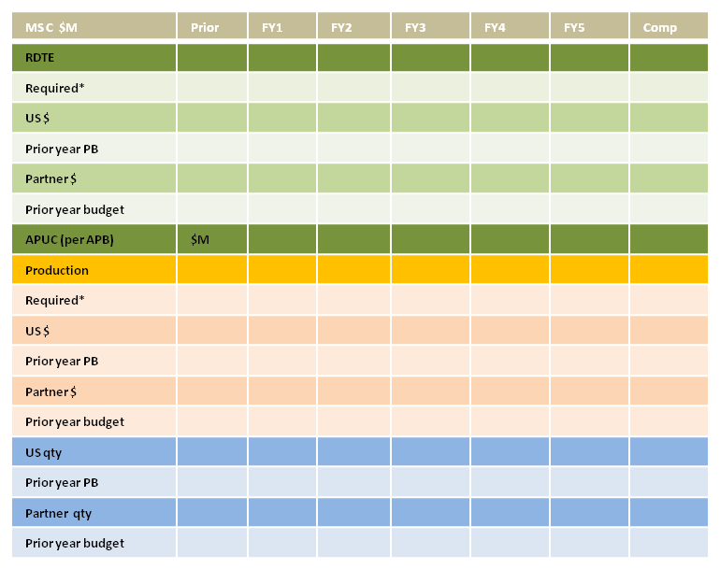
Cooperative Activities: (list cooperative partners, describe cooperative participation in the program, both current and planned, to include list of actual international agreements-- e.g., bilateral or multilateral discussions, loans of equipment, information exchanges, cooperative RDT&E, co-production DEA/IEAs in technology area, etc.)
Foreign sales: (list current or potential FMS or Direct Commercial Sales buyers)
Interoperability Requirements: (list all international objective and threshold requirements in program documents (JCIDS and 5000 series); describe plan to achieve those requirements, to include which increment of a program they will be achieved)
Foreign technology assessment: (from TDS and AoA; guidance in Deskbook Acquisition Guidebook, Section 2.3.6., identify how 10USC2350a statutory requirement has been met; assessment whether or not a project similar capability is in development or production in a partner nation that could be procured or modified to meet DoD needs)
Choose appropriate funding chart below
*-from Spruill chart
Key Technologies: (description of the technologies and CPI in the program)
Anti-Tamper Analysis: (based on ATEA Guidance and Defense Exportability assessment)
Differential Capability Analysis: (Assess potential need for development of differential capabilities for a range of anticipated coalition partners in view of the interoperability requirements, cooperative activities, and potential foreign sales efforts envisioned)
Proposed Approach: (Describe how design and development of validated AT and Differential Capability requirements will be addressed in the program’s master schedule )
(Identify issues specific to international -- e.g., impact (cost, schedule, performance) of proposed cuts on partner(s)/buyer(s), updated APUC, status of negotiations and impact to US and partners under the relevant agreement(s) (MOU, MOA, LOA)

Slide 36
Program Office Resources
Address Critical manpower positions / expertise (program office manning) & facilities
Provide Organizational Structure (Org Chart)
Resources
  Identify current DAWIA certification levels for all key government personnel (SPMs, PMs, etc.)
  Program Office Staffing and Support Contractor Resources Available to PM
    Identify any shortage of personnel
Integrated Product Teams (IPTs)
Notes:
As you move into this phase of the program, if you have not already have as one of your Key Leadership Positions (KLP) a Chief Developmental
Tester as required by the latest revision to 10 USC Section 139(c). A Chief Developmental Tester is required for MDAP and MAIS programs who must be a in a T-coded KLP slot. There is also a lack of qualified Information Assurance and cyber-security test practitioners who can give
DIACAP certification and accreditation.

Slide 37
APB Summary
Cost Baseline (TY$M) | Objective |  | Threshold
RDT&E | $282.5M |  | N/A
Procurement | $9.4M |  | N/A
Acq O&M | $0M |  | N/A
Total Acq Cost | $291.9M |  | N/A
O&S | $174.9M |  | N/A
Total Life Cycle Cost | $466.8M |  | N/A
Schedule Baseline | Objective |  | Threshold
MS B | Feb 2008 |  | Aug 2008
MS C | Nov 2011 |  | May 2012
FDD | Nov 2012 |  | May 2013
FD | TBD* |  | TBD*
Notes:
Recommend limiting schedule milestones in the APB to the top level milestones identified in the slide. By holding the PM to additional lower level milestones may result in an APB breach (Nunn McCurdy or Significant Change) that may not otherwise be a huge impact to the program.
Defense Acquisition Guidebook: 2.1.1 The APB
Program goals consist of an objective value and a threshold value for each parameter. Objective values represent what the user desires and expects. The program manager manages the program to the objective value of each parameter. Thresholds represent the acceptable limits to the parameter values that, in the user's judgment, still provide the needed capability. For performance, a threshold represents either a minimum or maximum acceptable value, while for schedule and cost parameters, thresholds would normally represent maximum allowable values. The failure to attain program thresholds may degrade system performance, delay the program (possibly impacting related programs or systems), or make the program too costly. The failure to attain program thresholds, therefore, places the overall affordability of the program and/or the capability provided by the system into question.
For each parameter, if no objective is specified, the threshold value should also serve as the objective value. As a general rule, if no threshold is specified, the performance objective value should also serve as the performance threshold value; the schedule objective value plus 6 months for ACAT I or 3 months for ACAT IA should serve as the schedule threshold value; or the cost objective value plus 10 percent should serve as the cost threshold value. Despite these guidelines, if no threshold is specified, the PM may propose an appropriate threshold value to optimize program trade-space, subject to MDA and user approval.
APB parameter values should represent the program as it is expected to be developed, produced and/or deployed, and funded. The baseline should only contain those parameters that, if thresholds are not met, will require the MDA to re-evaluate the program and consider alternative program concepts or design approaches. The number of performance parameters should be limited to provide maximum trade space.
Per 10 USC 2435, the DoD may not obligate funds for MDAPs after entry into EMD without a MDA-approved baseline unless the OSD/AT&L specifically approves the obligation. DODI 5000.2 extends this policy to ACAT IA programs. For an ACAT IA program, ASD/NII must approve the obligation.

Slide 38
Cost Driver/Operational Requirements
Trade Space
Requirement Cost Driver (i.e. KPP, KSA, other attributes) | Proposed Relaxed Requirements | Operational Risk/Impact | Reduced System Capability | Change in Cost (e.g. LCCE, APUC, RDT&E, Production, O&S, etc.)
KPP 1 : Radar System Performance | Increase search update interval by 5 seconds | Reduces TBM growth capability | Req’d power aperture decreased by 15% | $50M reduction in RDT&E
KPP 2: Sustainment Material Availability | Relax from 64% to 50% | Possibly unable to meet optimum 36mo. maintenance cycles so as to maintain Mission Readiness | Req 2 new aircraft instead of 3 | $9B reduction in LCCE
KPP 3: Mission Execution (Comm) | Partially enable wireless communication | Unable to provide full C3 capability – reduce responsiveness | Integrate with only basic wireless capability | $10M reduction in RDT&E
Notes:
This chart is intended to help the program generate ideas for potential tradeoffs. Data may or may not be available depending on the timing of the Milestone. The table includes operational requirements that are potential tradeoffs and the associated operational and cost impact of the trade. The table includes the KPPs, KSAs, and APAs that are the primary cost and schedule drivers.

